Slide 1

Abbreviated* Ecosystem Status Report – Gulf of Alaska 2025
GOA Assessment 2025 [implications for GOA Pacific cod]
Warm at surface and depth, in winter, spring and fall 2025
[winter spawning; egg/larval survival; incr. demand for prey]
Reduced lower trophic level productivity
[less productive food web to directly and indirectly support cod prey]
Warm-affiliated phytoplankton and zooplankton communities,
Spring reduced CPUE of larval groundfish,
Below-average body condition of zooplanktivorous groundfish & Glacier Bay humpback whales
Moderate upper trophic level productivity
[cod body condition below average but some prey base is ok]
Multi-year reduction adult P. cod body condition to below average
But also some signs of good productivity (forage fish, seabirds)
Cooling in 2026 - but concern over residual heat in the GOA water column and cumulative ecosystem impacts from 2025
[potential increased thermal and food web stress for cod]
GOA Risk Tables
Ecosystem Considerations & Population Dynamics
Pacific cod (+ESP)
Cook Inlet coho salmon
*Abbreviated: missing some contributions, report cards, and Appendices. The evaluation of risk table factors for GOA P. cod was not impacted by these missing components.

Slide 2
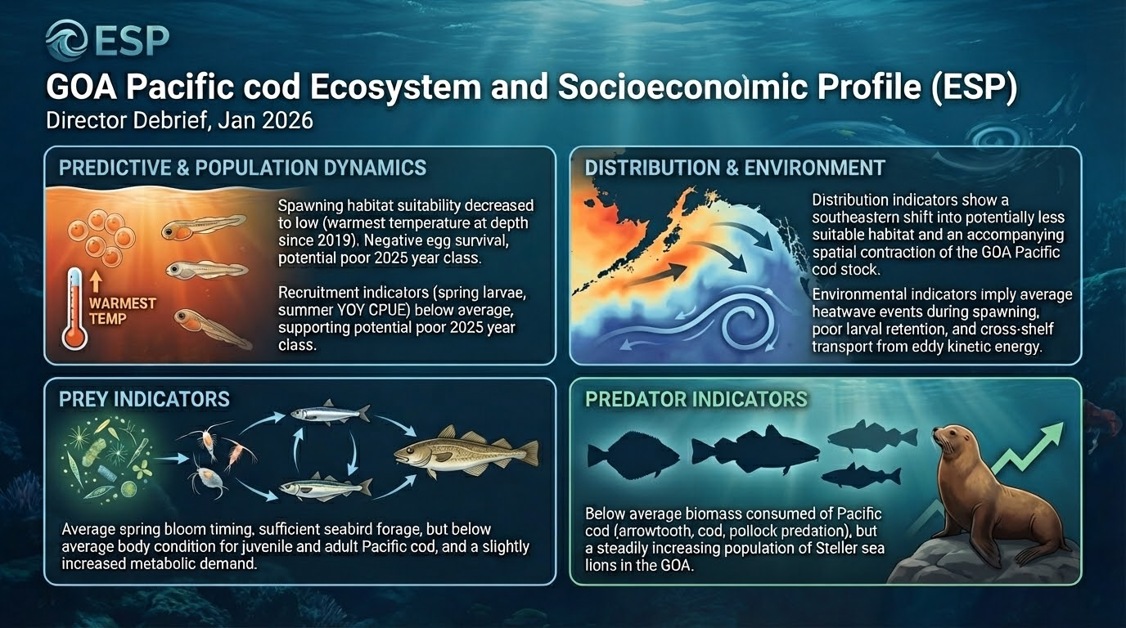
Notes:
Beautified version of previous slide, use this if only want one slide
Here are the highlights of the GOA Pcod ESP Update Report. This is the front page of the report card graphic.
There was one predictive indicator based on the updated Bayesian Adaptative Sampling or BAS analysis. That's a change from last year where there was two, but one dropped out in the analysis this year. Spawning habitat suitability decreased to low due to the warmest temperature at depth since 2019. This may have a negative effect on egg survival and potentially mean a poor 2025 year class. This model fits the recruitment time series fairly well but does not capture the downward swing in the last five years.
That poor recruitment for 2025 is also supported by below average spring larvae (EcoFOCI) and summer YOY (Beach Seine) CPUE. These additional recruitment indicators were not used in the statistical analysis because they have too short or gappy time series.
The remainder of the contextual ecosystem indicators were overall average status with mixed directional trends from 2024 to 2025 conditions. These are organized into distribution, environment, prey, and predator following the ESR format.
Distribution indicators show a southeastern shift into potentially less suitable habitat and an accompanying spatial contraction of the GOA Pacific cod stock.
Environmental indicators imply average heatwave events during spawning with poor larval retention and cross-shelf transport from eddy kinetic energy.
Prey indicators show average spring bloom timing, sufficient forage resources for seabirds, but below average body condition for juvenile and adult Pacific cod and a slightly increased metabolic demand.
Predator indicators were below average biomass consumed of Pacific cod based on arrowtooth, Pacific cod, and pollock predation in the multispecies model but a steadily increasing population of Steller sea lions in the GOA.

Slide 3
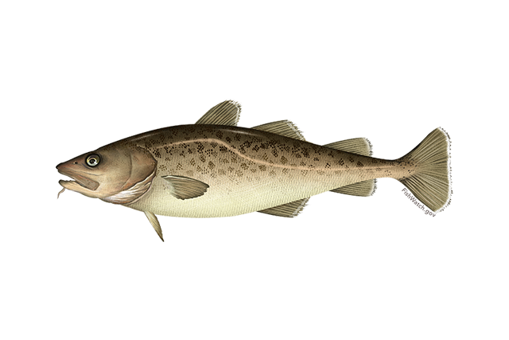

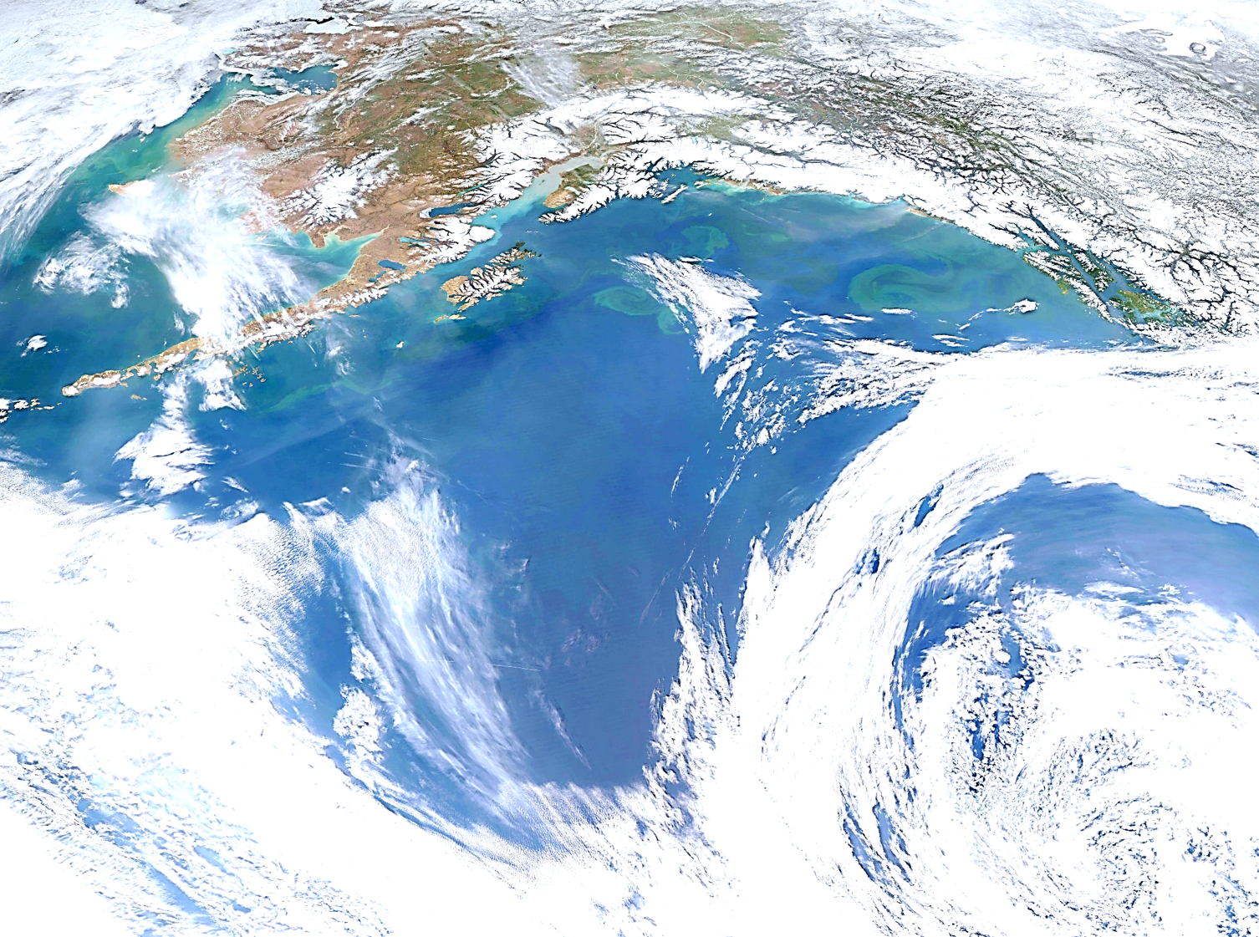
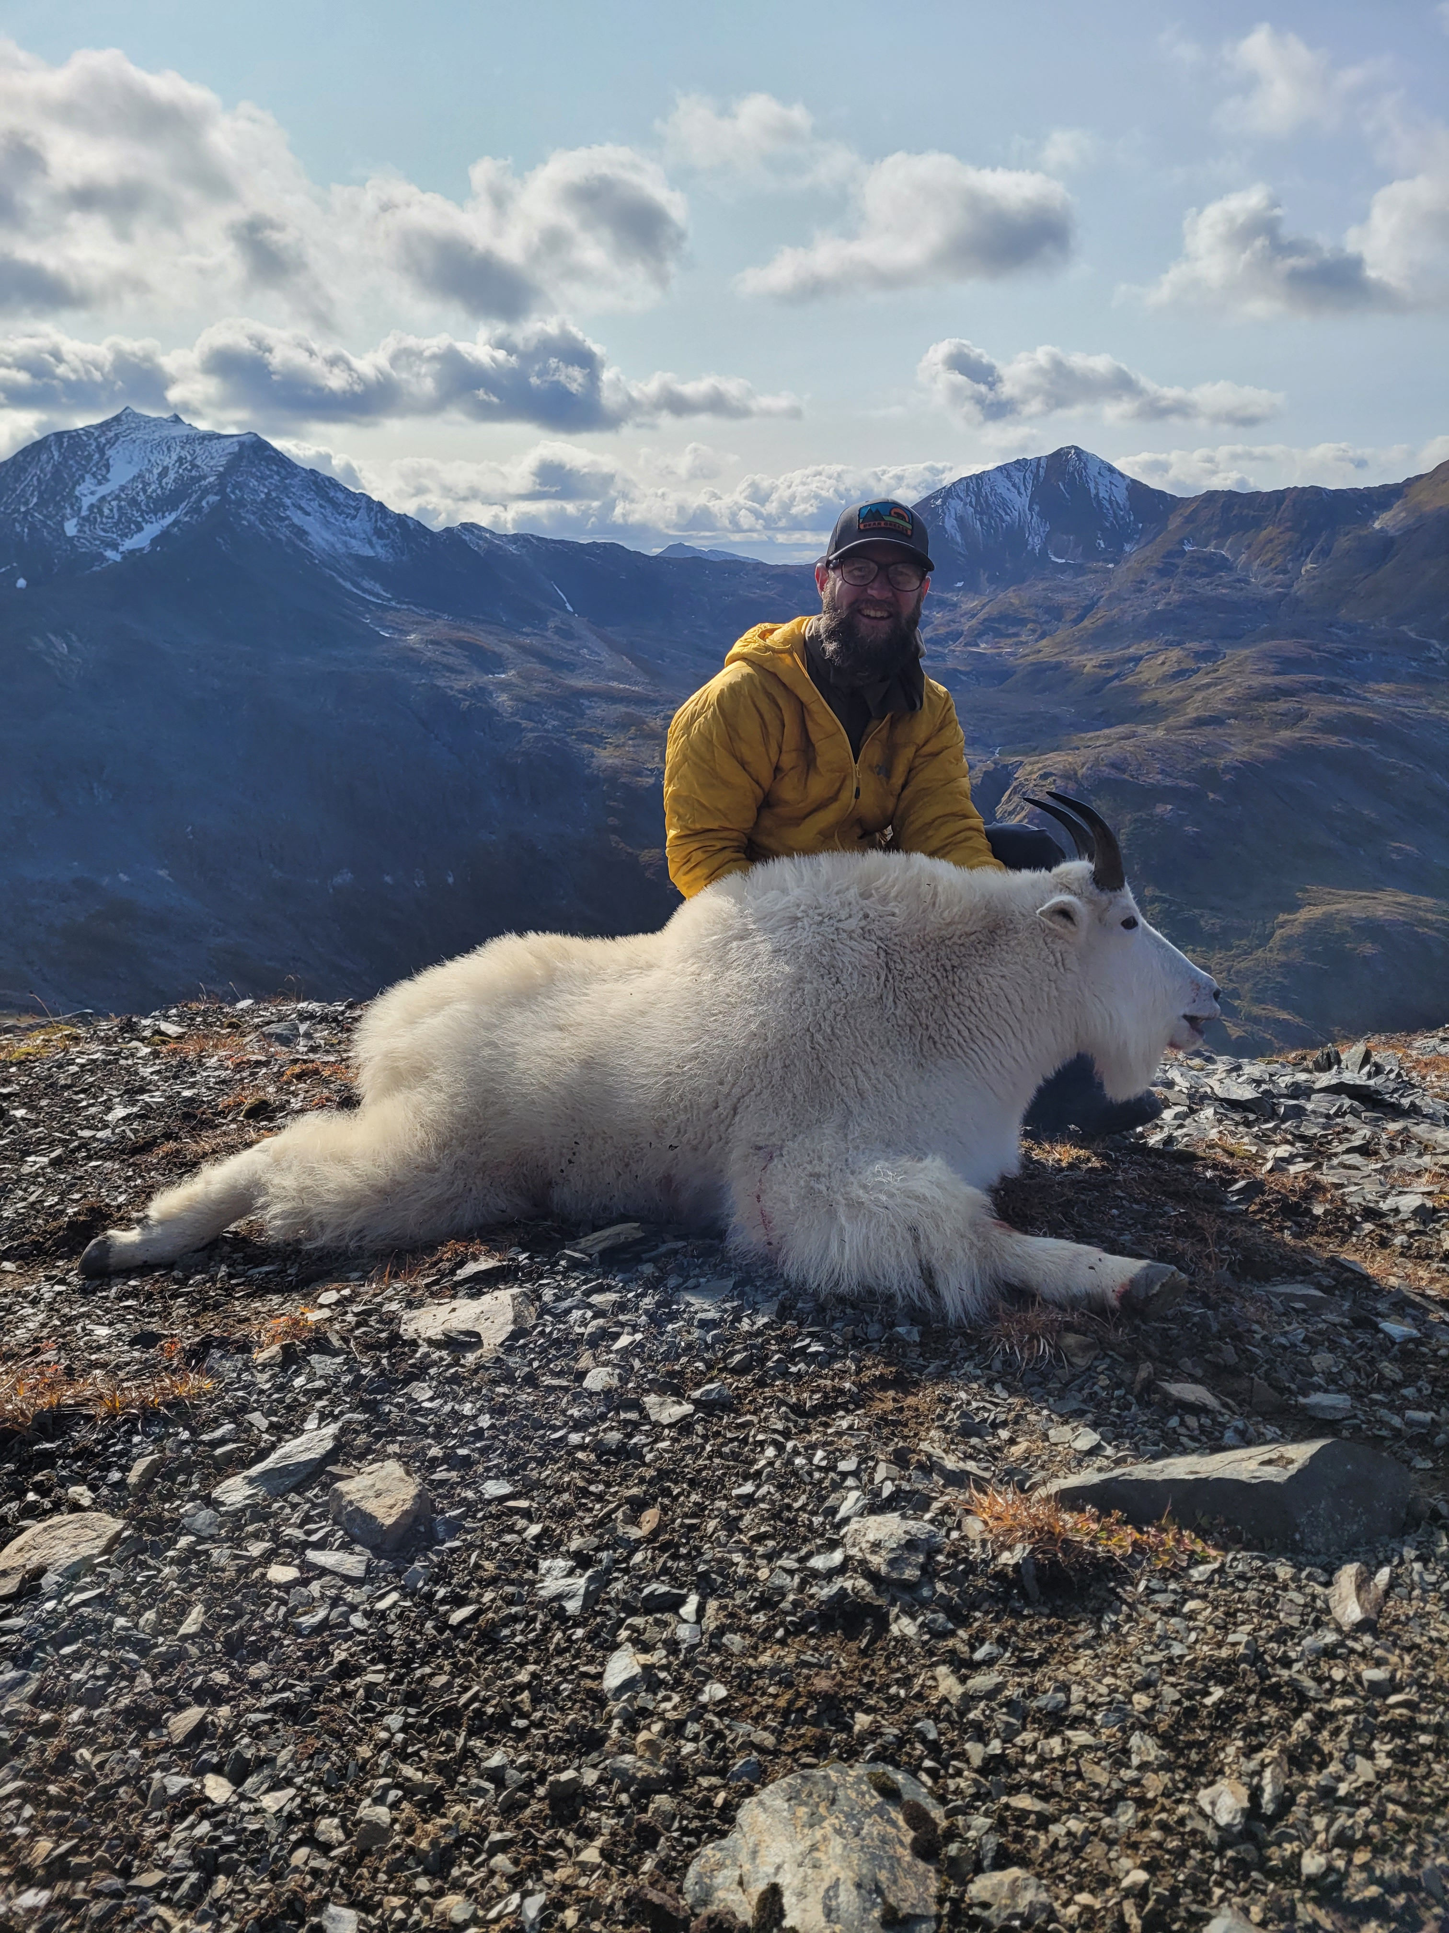

Goa pacific cod
P. hulson, s. barbeaux, b. ferriss, k. echave, J. Nielsen, S. McDermott, b. laurel, a. abookire, Ingrid spies, and s. k. shotwell
January 2026, Presentation to the GOA Plan Team

Slide 4
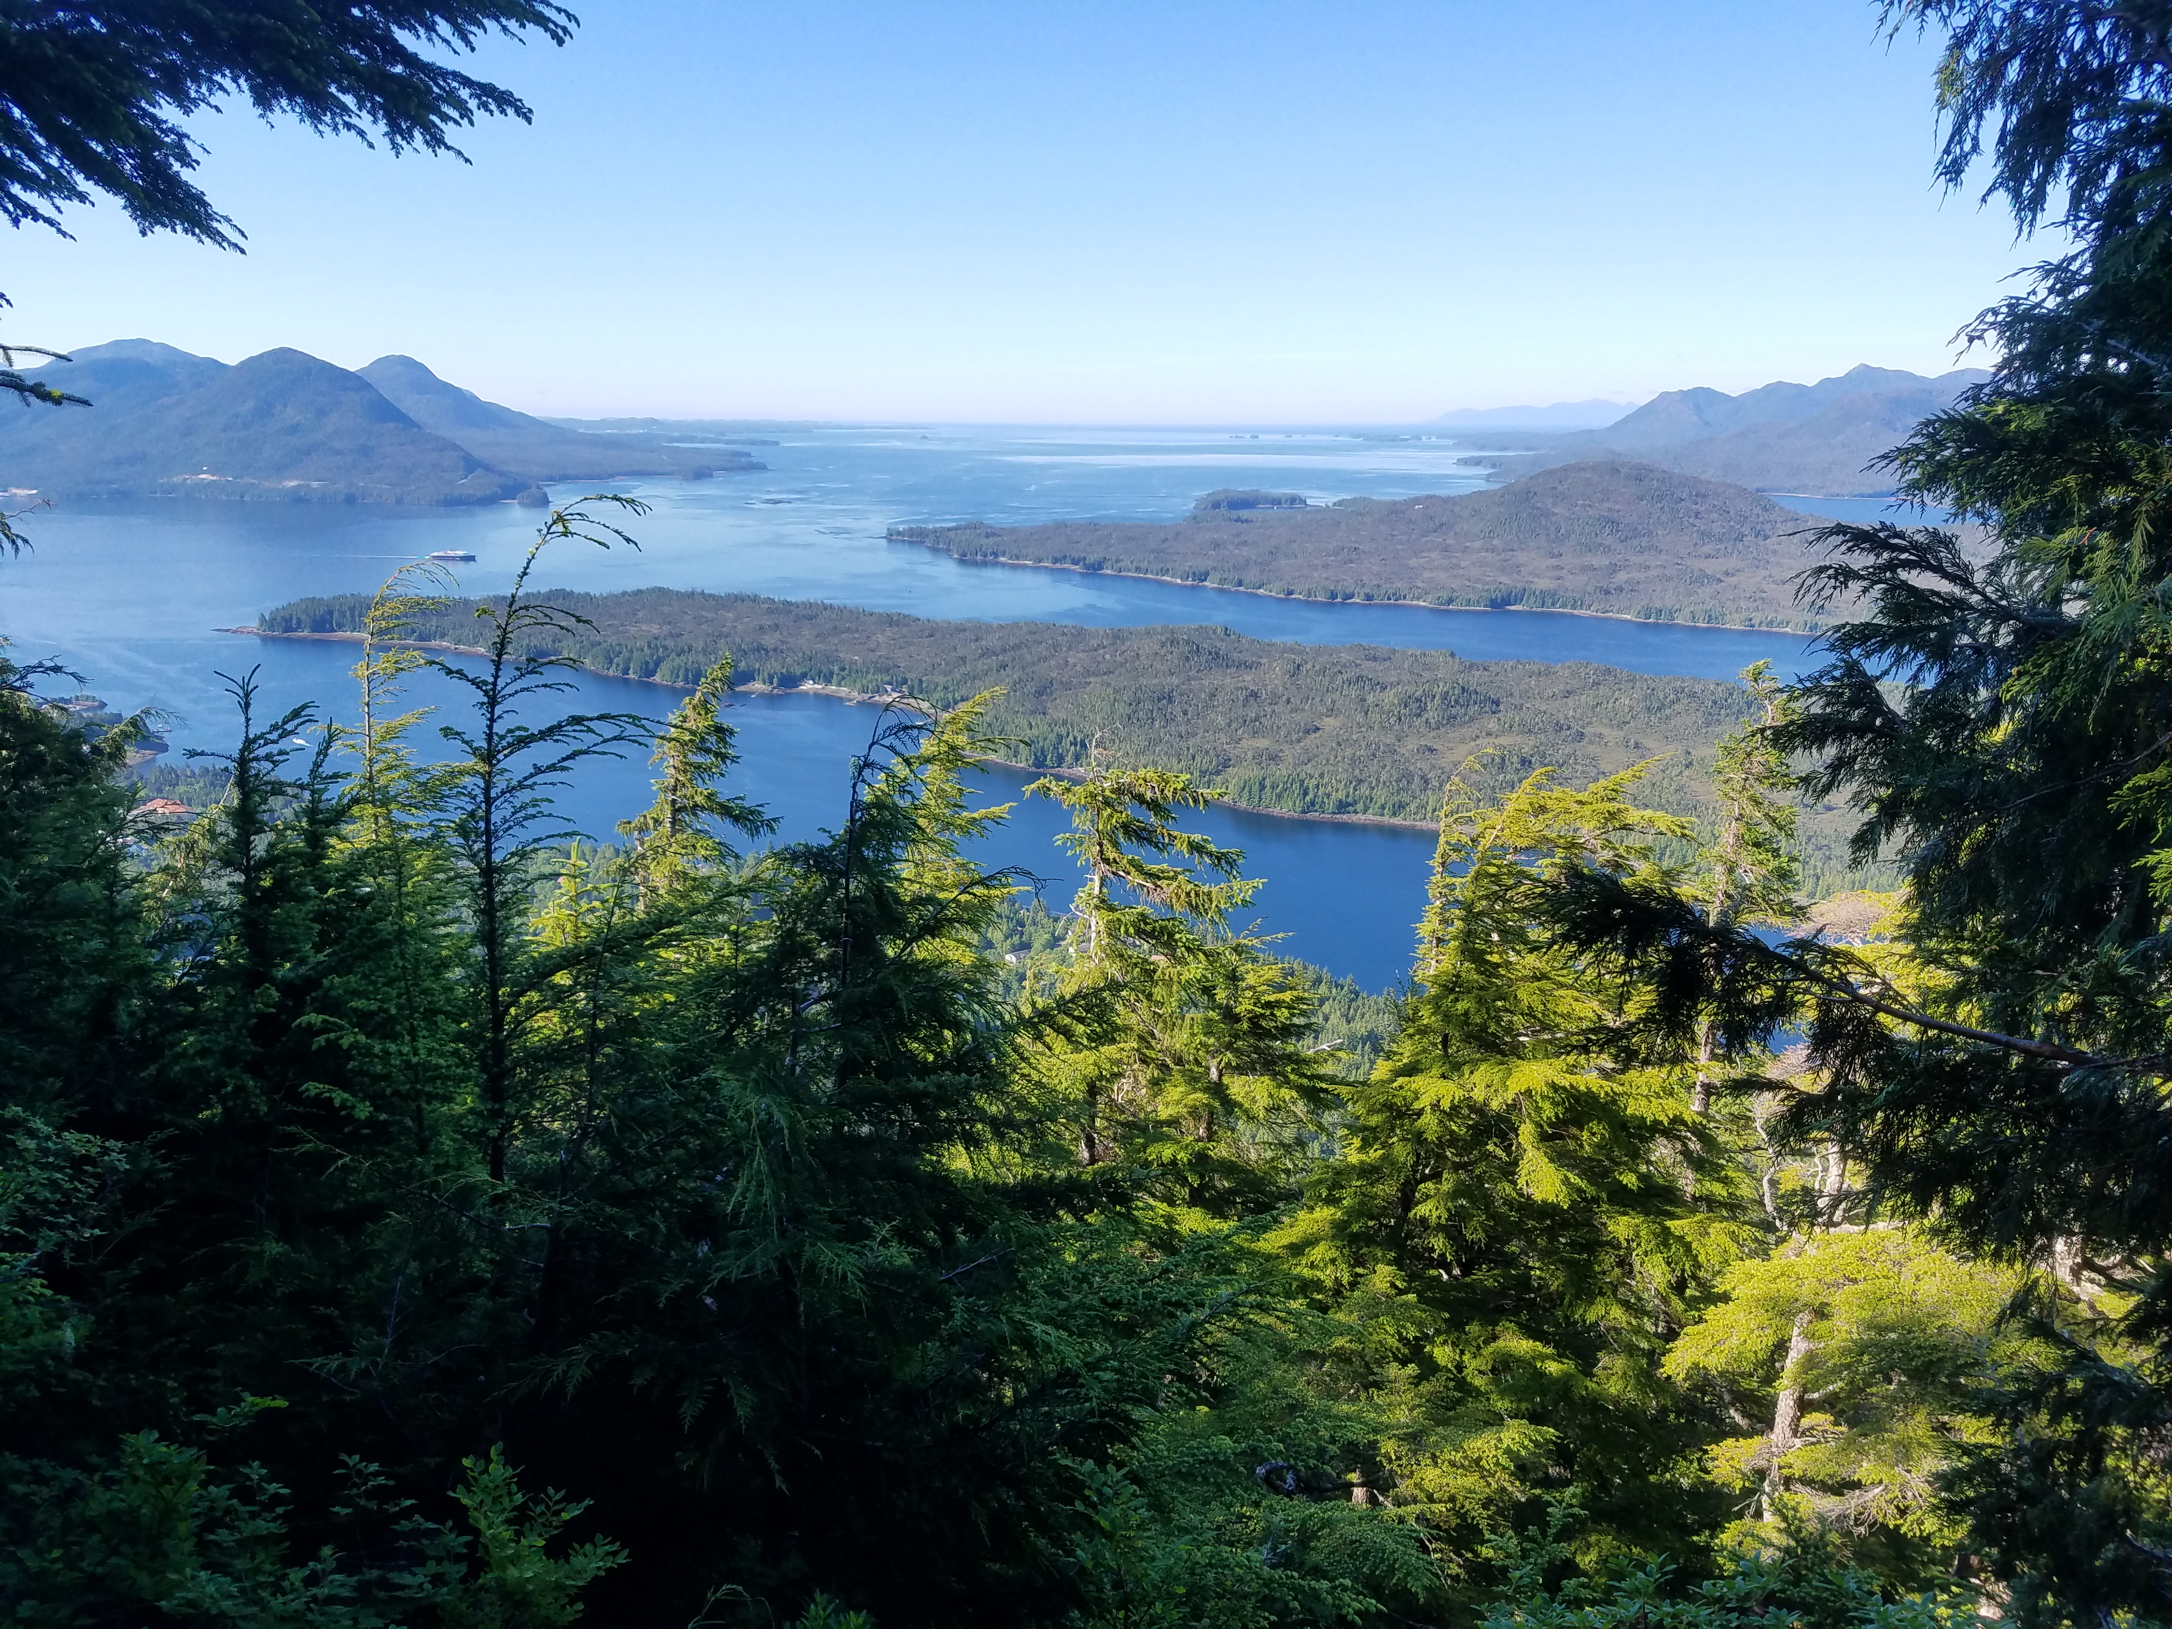
Assessment overview
BLUF:
GOA Pacific cod: Tier 3b
2025 estimated spawning biomass to be at B_{34.3%}, projected in 2026 to be at B_{33.1%}
2026 recommended ABC 29% increase from 2025 ABC
Do not recommend reduction from maximum ABC
Outline:
Updated assessment overview
Updated data through 2025
Model results
ABC/BRD recommendations

Slide 5
Updated assessment overview
2025/2026 GOA Pacific cod is an update assessment
Only new data through 2025 included, no model changes
Abbreviated SAFE document
Only sections that have been updated with new information since 2024 assessment included
Any missing sections (e.g., full Introduction) can be found in the 2024 SAFE
SSC/PT comments and responses not included, will be included and addressed in the next full assessment
Additional model files, results, and diagnostics area available electronically at this link

Slide 6

Assessment evaluation Outline
Data
Fishery
Results
Data fit
Recommendations
Risk Table
Survey
Other
Model evaluation
Model estimates
ABC/OFL
BRD

Slide 7

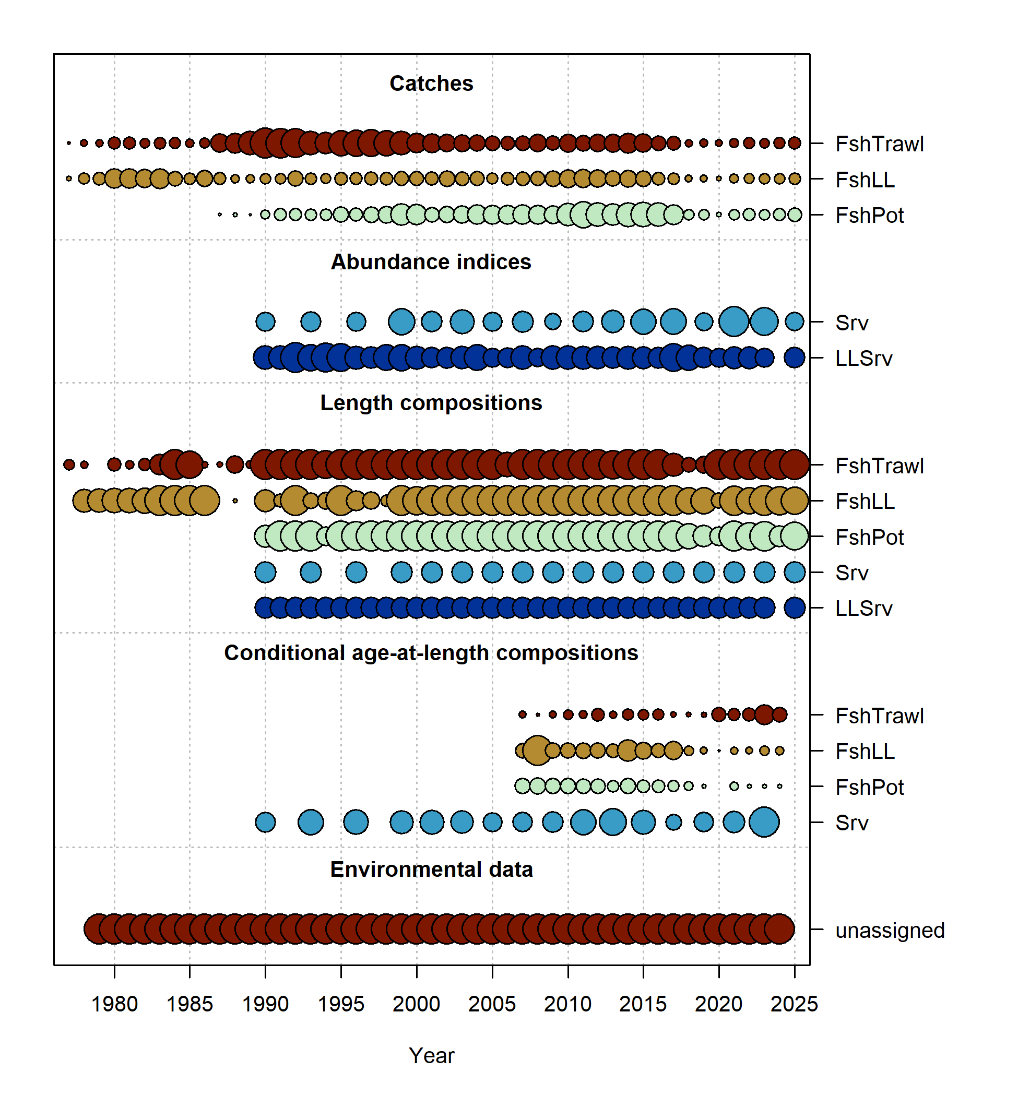
Data overview
New Data | Years
Federal and state fishery catch, by gear type | 2024, 2025
Federal and state fishery length composition, by gear type | 2024, 2025
Federal fishery conditional age-at-length | 2024
GOA AFSC bottom trawl survey abundance | 2025
GOA AFSC bottom trawl survey length composition | 2025
GOA AFSC longline survey Relative Population Numbers | 2025
GOA AFSC longline survey length composition | 2025

Slide 8
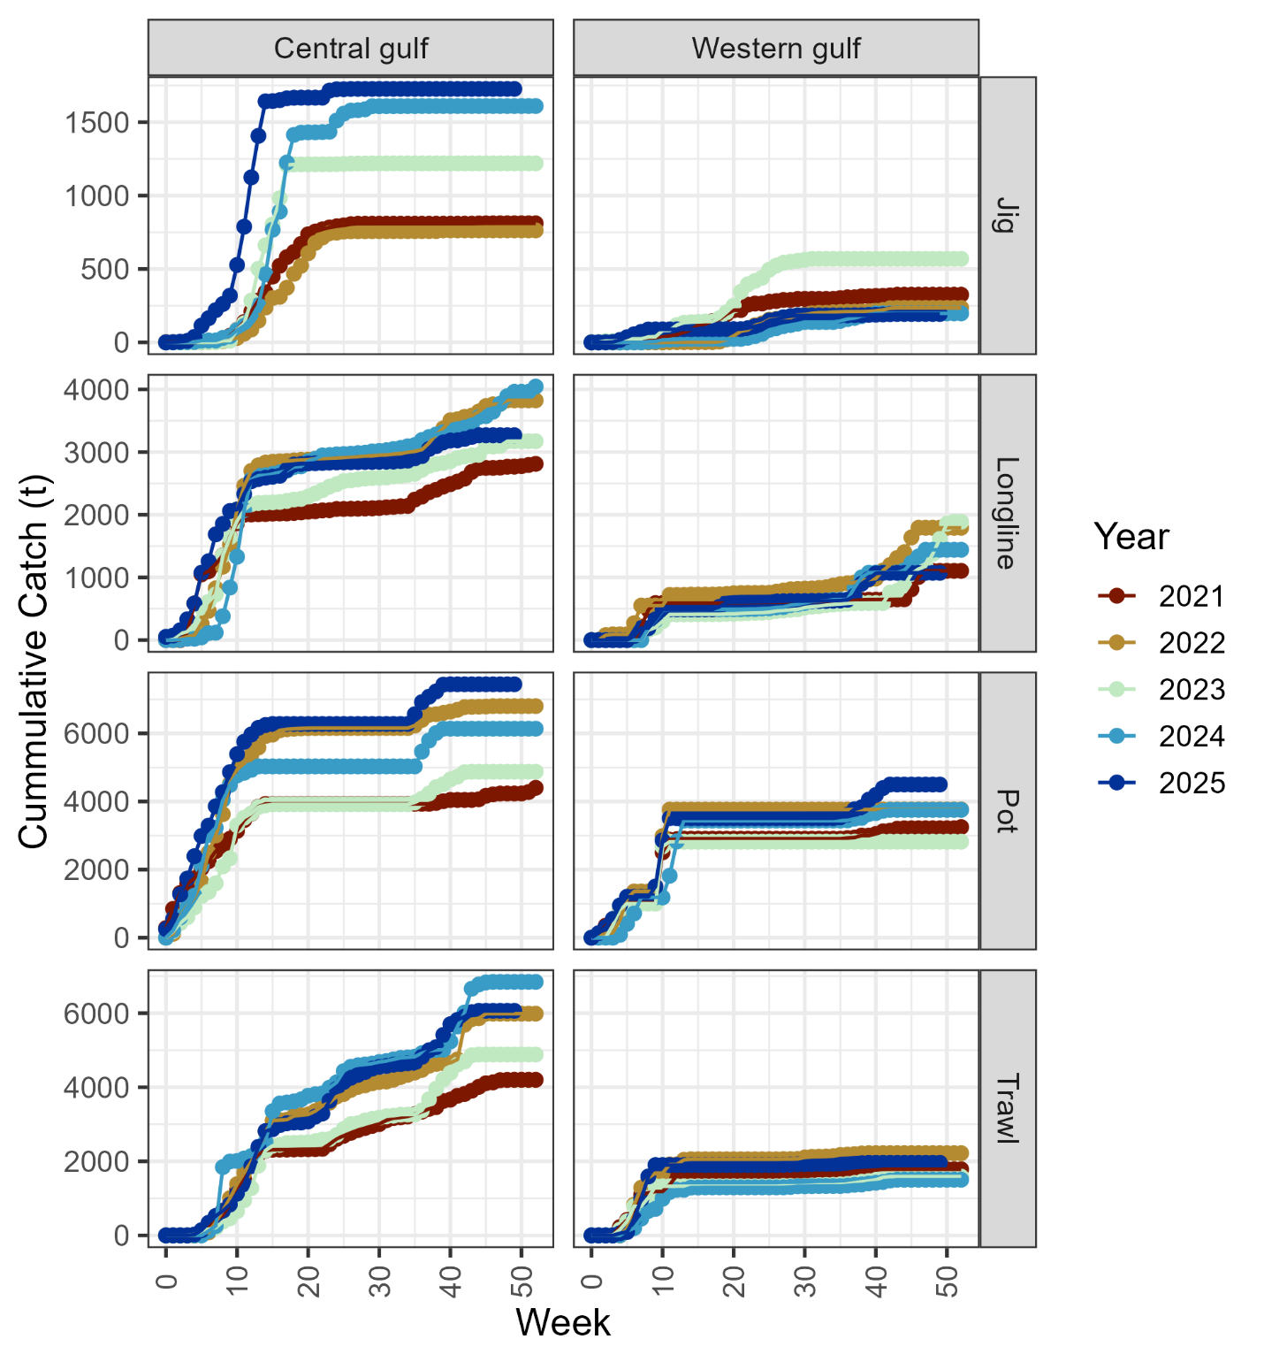
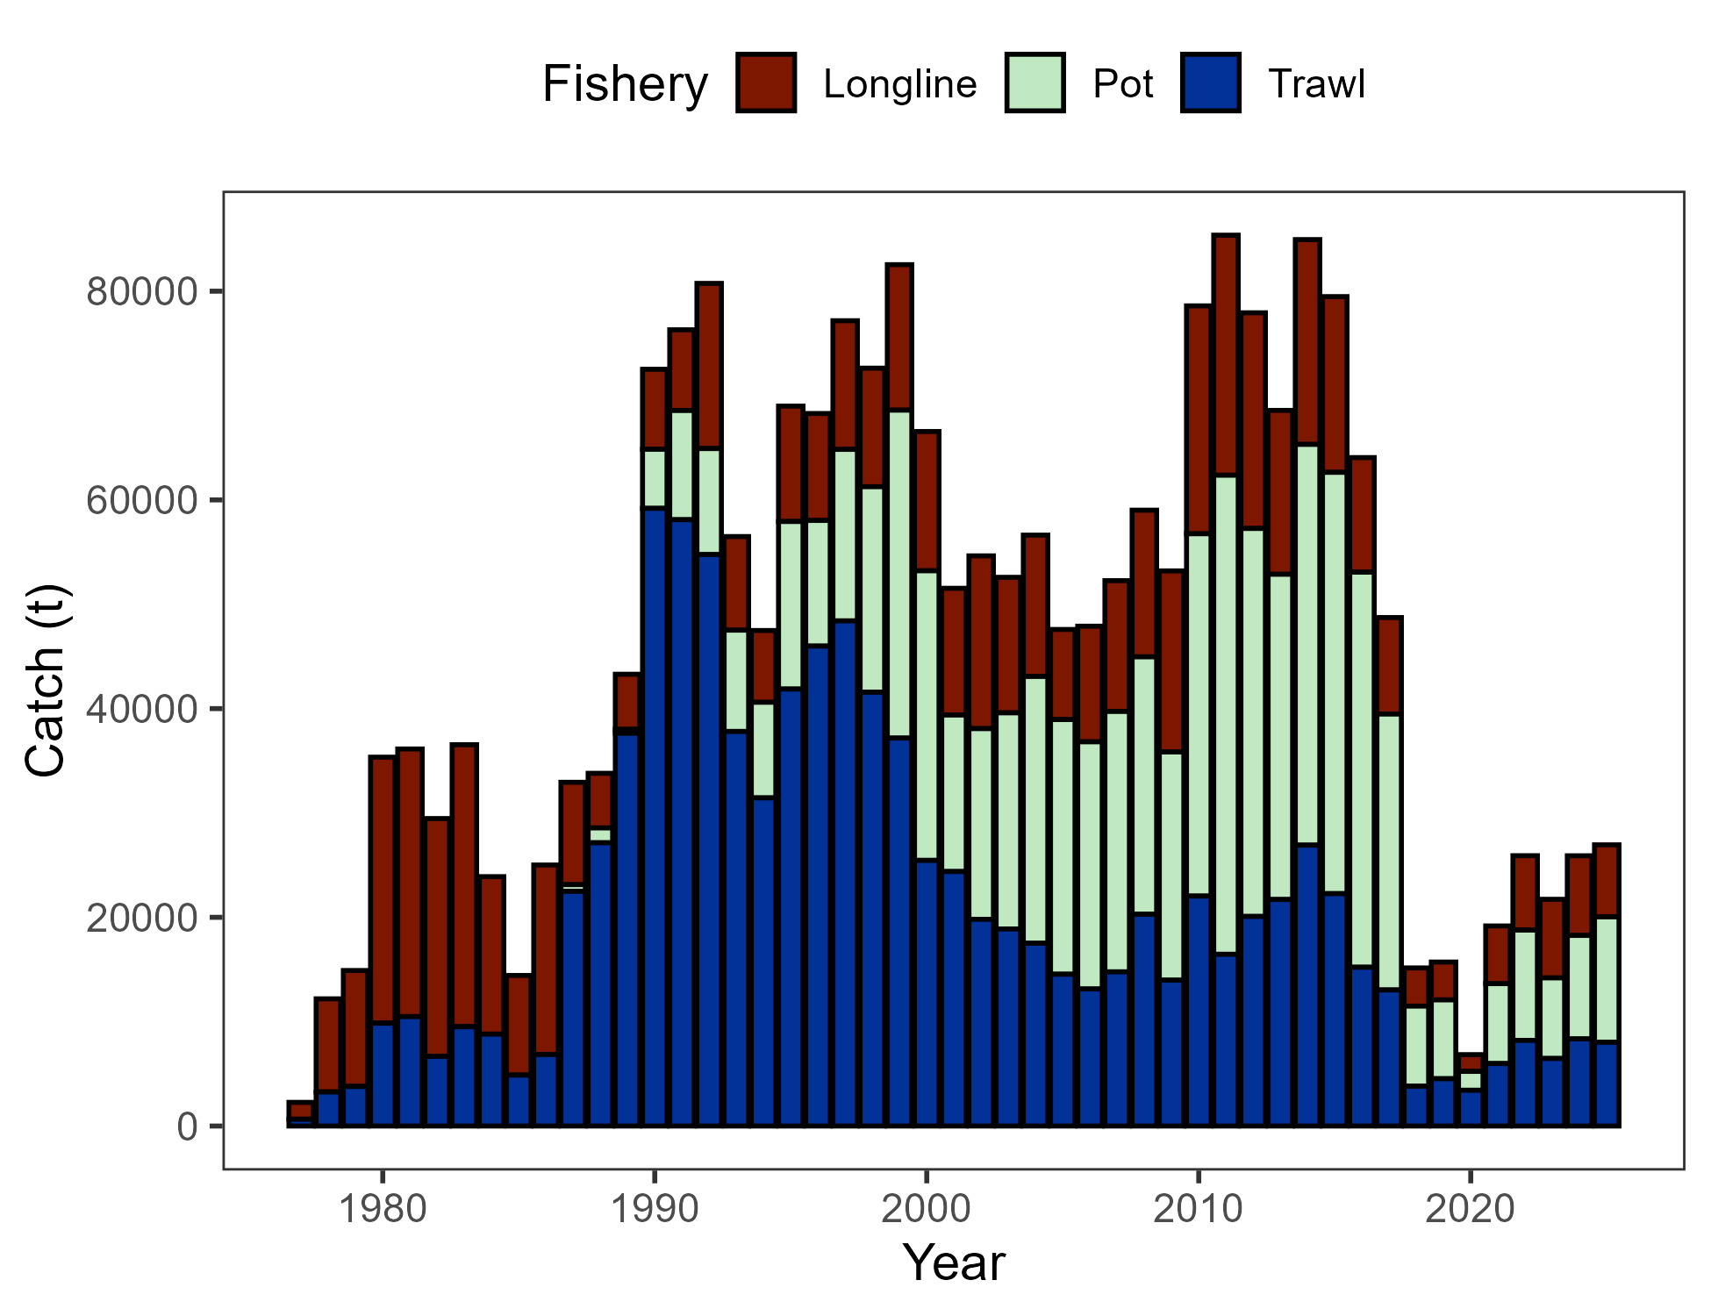
Data - Catch
Pot majority > LL > Trawl
Nothing inconsistent in cumulative catch to previous years
Catch through Dec 8, 2025

Slide 9
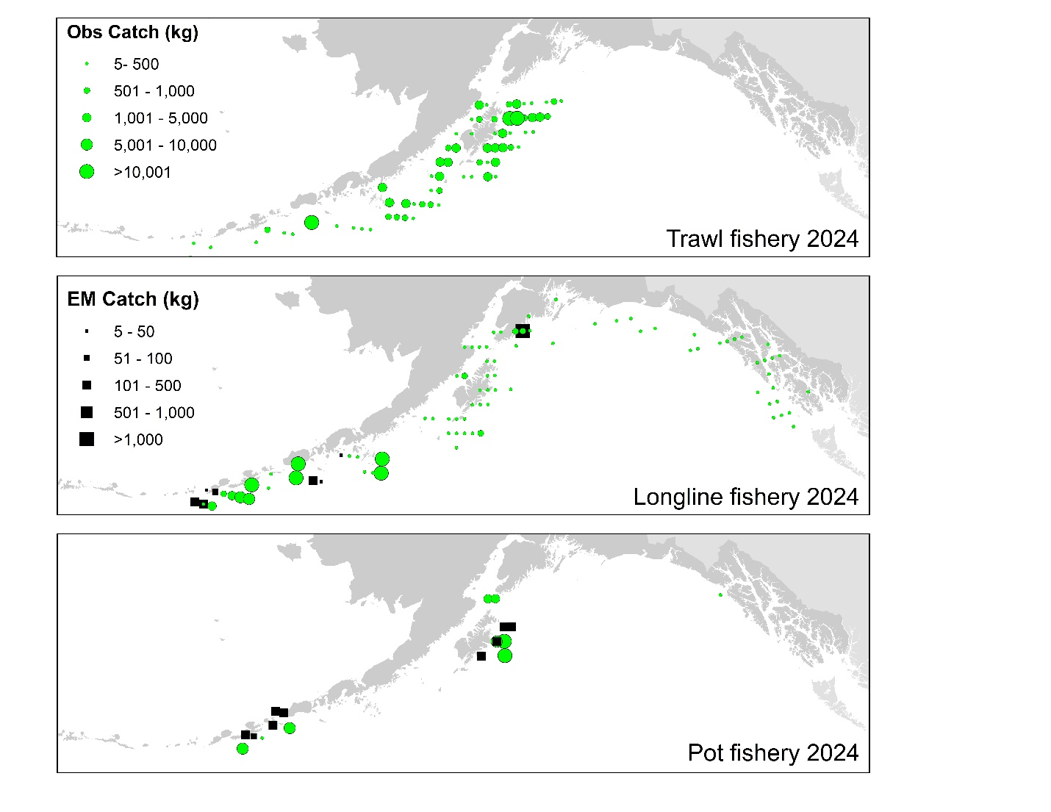
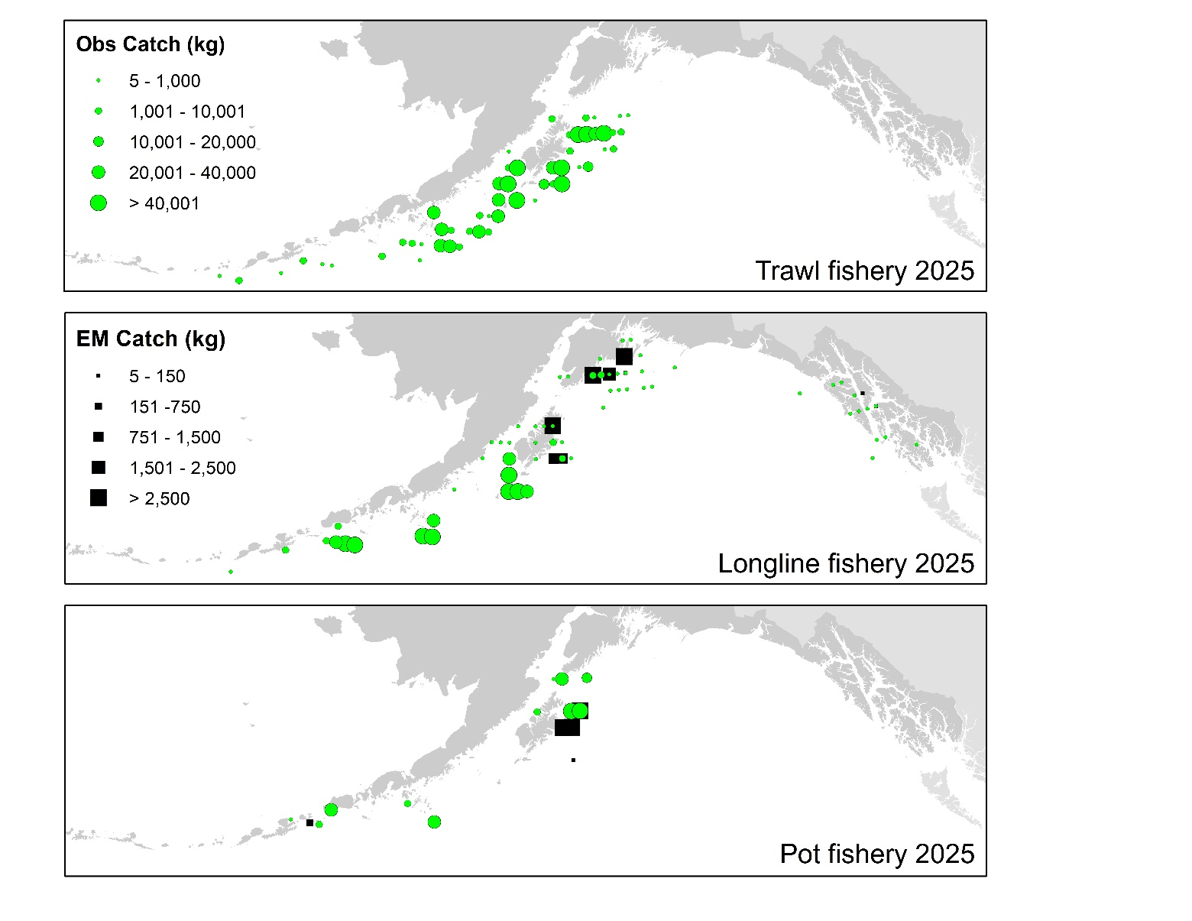
Data – Catch distribution
2025 distribution similar to previous catch distribution
For how much relative catch is taken by pot, small # observed hauls

Slide 10
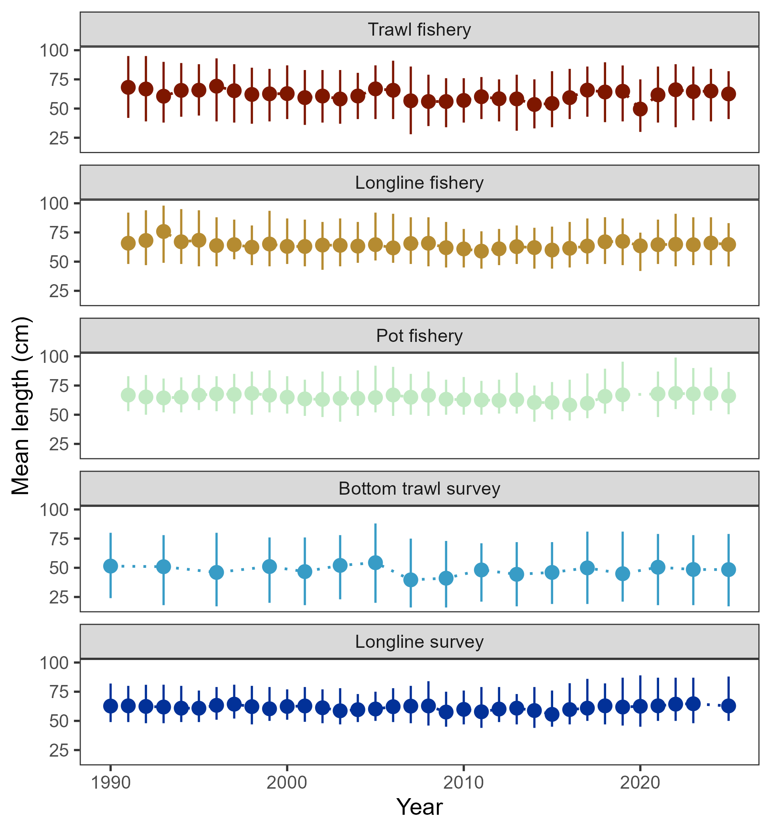
Data – length comps
In general, mean length in 2024 similar to that in previous 4 or so years

Slide 11
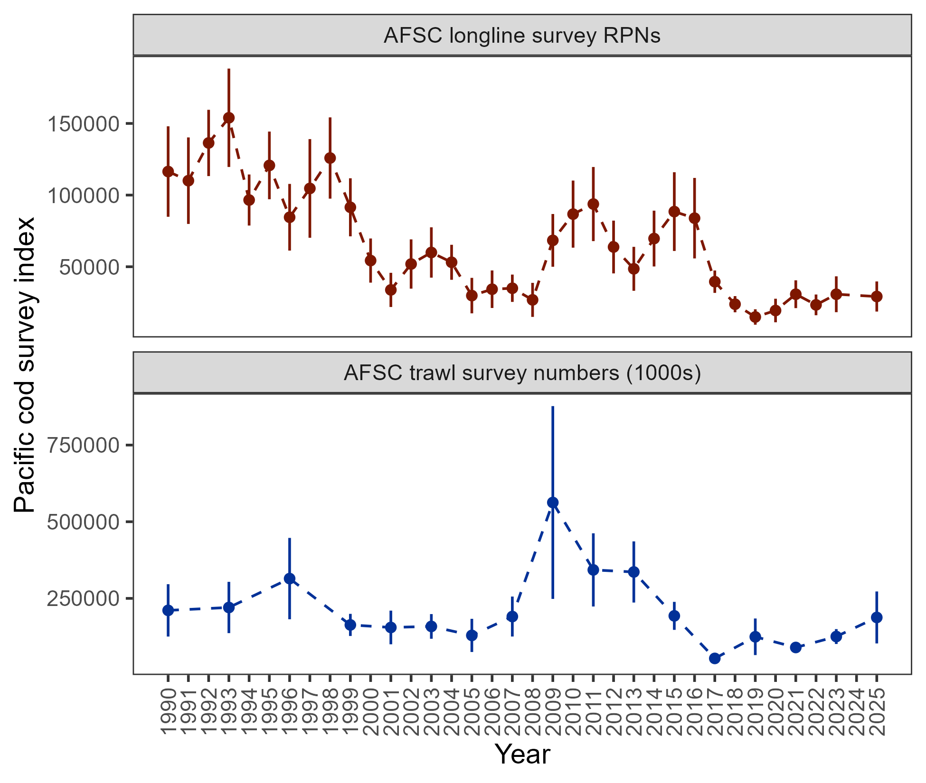
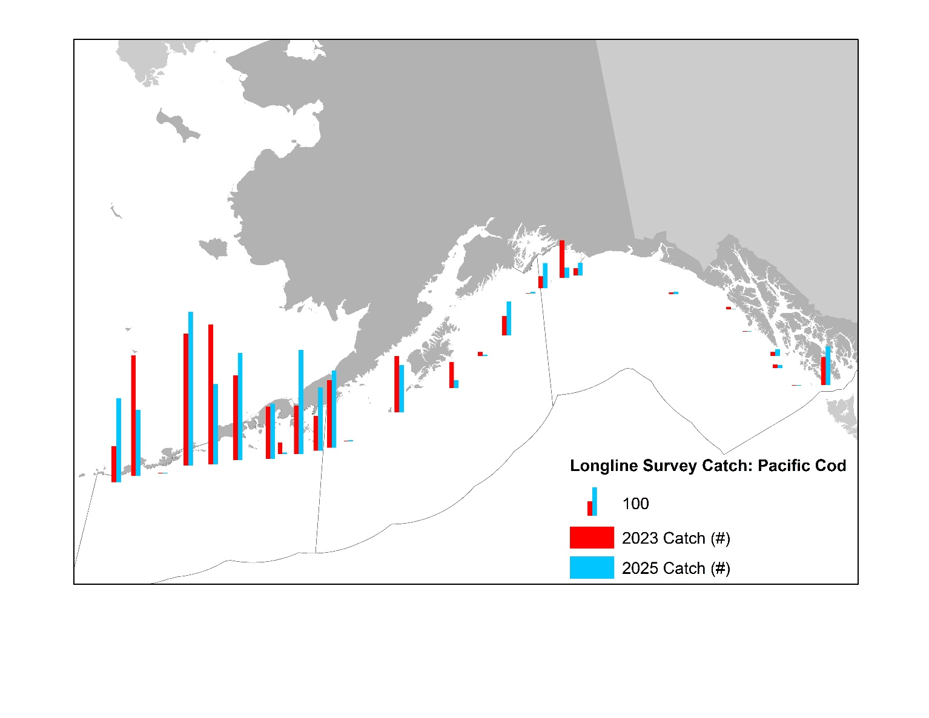
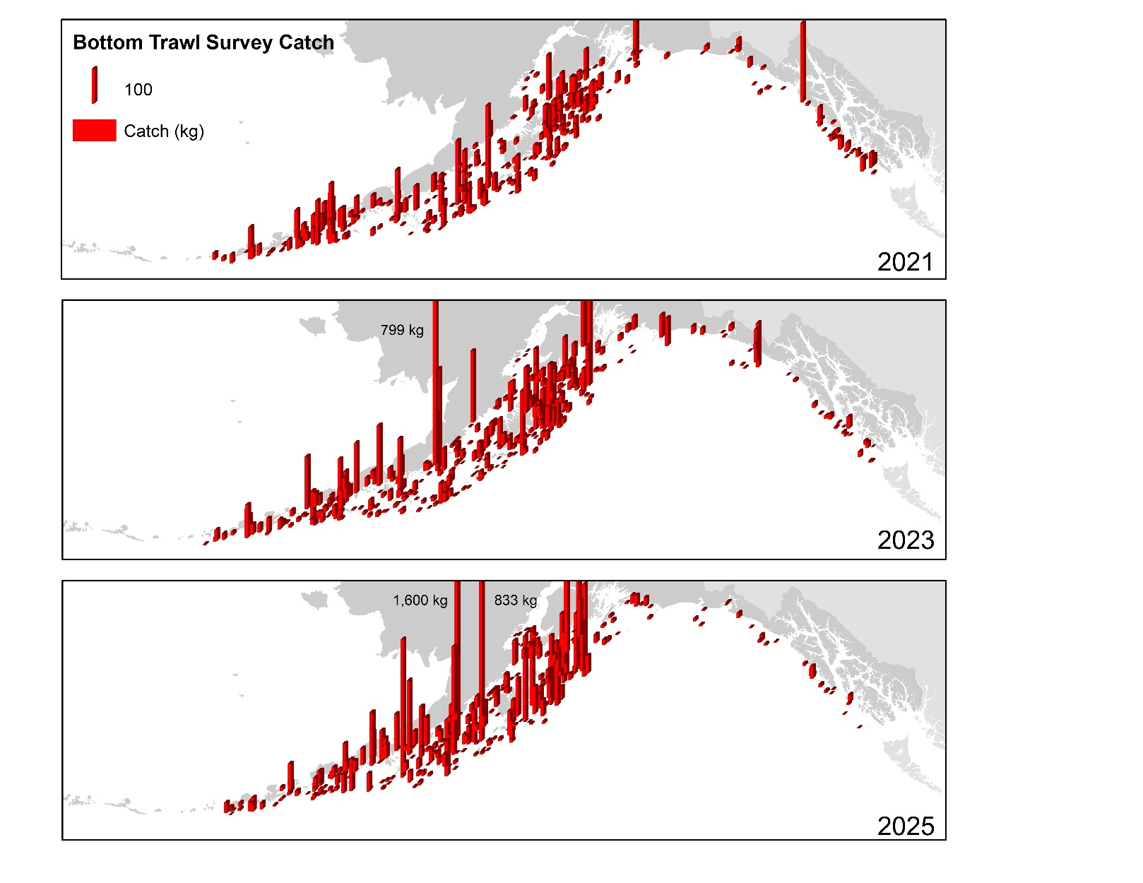
Data – afsc surveys
-5%
+49.6%

Slide 12
Data – afsc surveys
For a moment, taking a detour to put context in the survey results
Why was there an observed decline in longline survey RPNs?
Was there an influence of the GOA bottom trawl survey restratification on 2025 results?

Slide 13
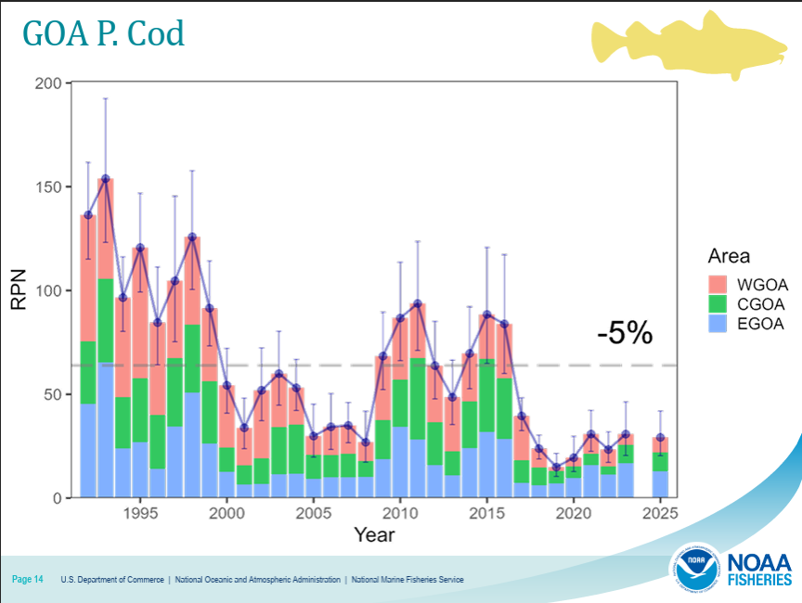
Data – afsc surveys
Why was there an observed decline in longline survey RPNs?
Subregion change since 2023: WGOA +40%, CGOA +4.8%, EGOA -23.6%
This decline in RPN due to influence of EGOA RPN, which is 44% of total GOA RPN
Siwicke Sept 25 PT presentation:

Slide 14
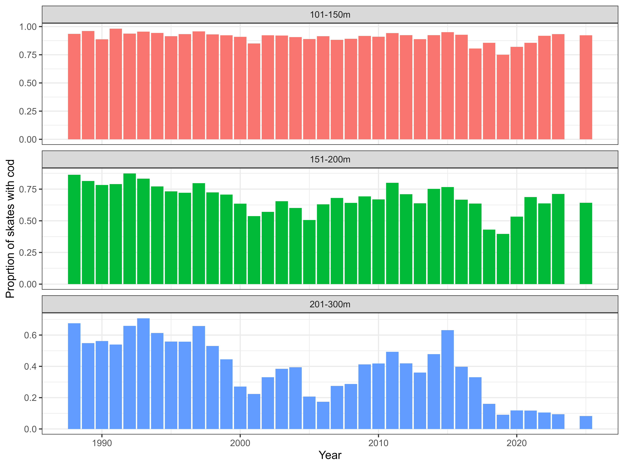
Data – afsc surveys
Why was there an observed decline in longline survey RPNs?
Drilling down into EGOA: Decline from 2025 due to single station
Why is EGOA RPN so large?
44% of GOA RPN whereas the AFSC bottom trawl survey observes <10% of cod pop’n in GOA resides
RRN calculated for depths start at 150m: Area size for 150-200m strata in EGOA as compared to CGOA-WGOA is much larger causing disproportionate effect on calculated RPNs

Slide 15
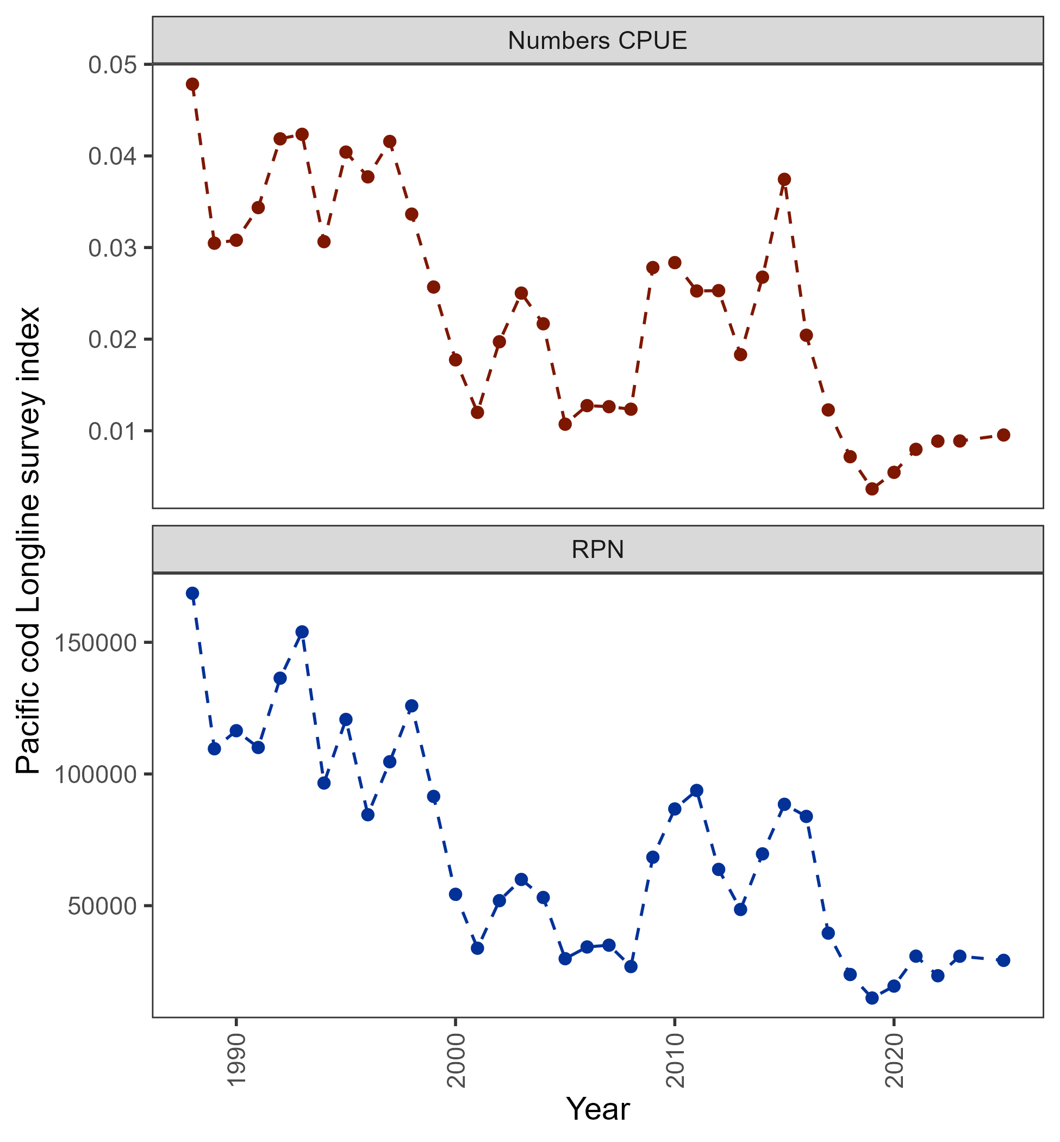
Data – afsc surveys
Why was there an observed decline in longline survey RPNs?
Subregion with lowest catch and fewest stations driving the AFSC longline survey index
While 5% decrease in RPN index, raw numbers CPUE increased by more than 7%
Prior to next full assessment we will be reevaluating how GOA Pacific cod RPN index computed
+7.4%
-5%

Slide 16
Data – afsc surveys
Was there an influence of the GOA bottom trawl survey restratification on 2025 results?
Appendix 2.2: with GAP (Oyafuso and Kotwicki) performed analysis in which historical survey data was restratified into 2025 strata for Pacific cod
Utilized survey R-package with historical hauls reweighted based on 2025 strata area sizes
Steps taken in analysis (code available at https://github.com/pete-hulson/goa_restrat)
Reclassified historical stations within new 2025 stratum boundaries
Post-stratified based on re-weighting station observations so that sum of weights in each new stratum matches its total area

Slide 17
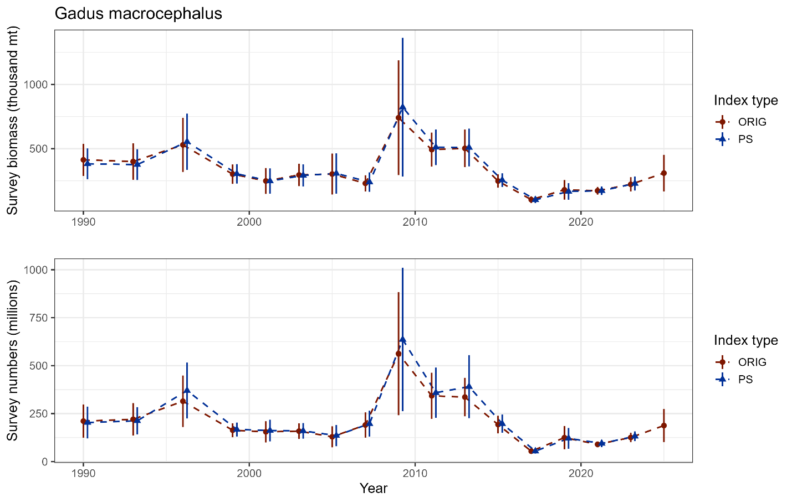
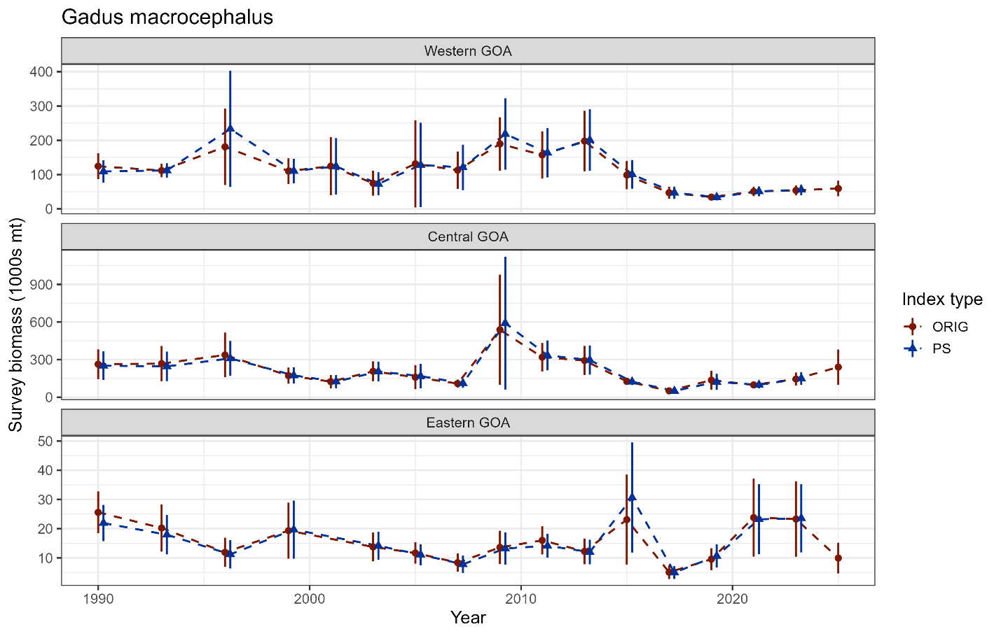
Data – afsc surveys
Was there an influence of the GOA bottom trawl survey restratification on 2025 results? NO

Slide 18

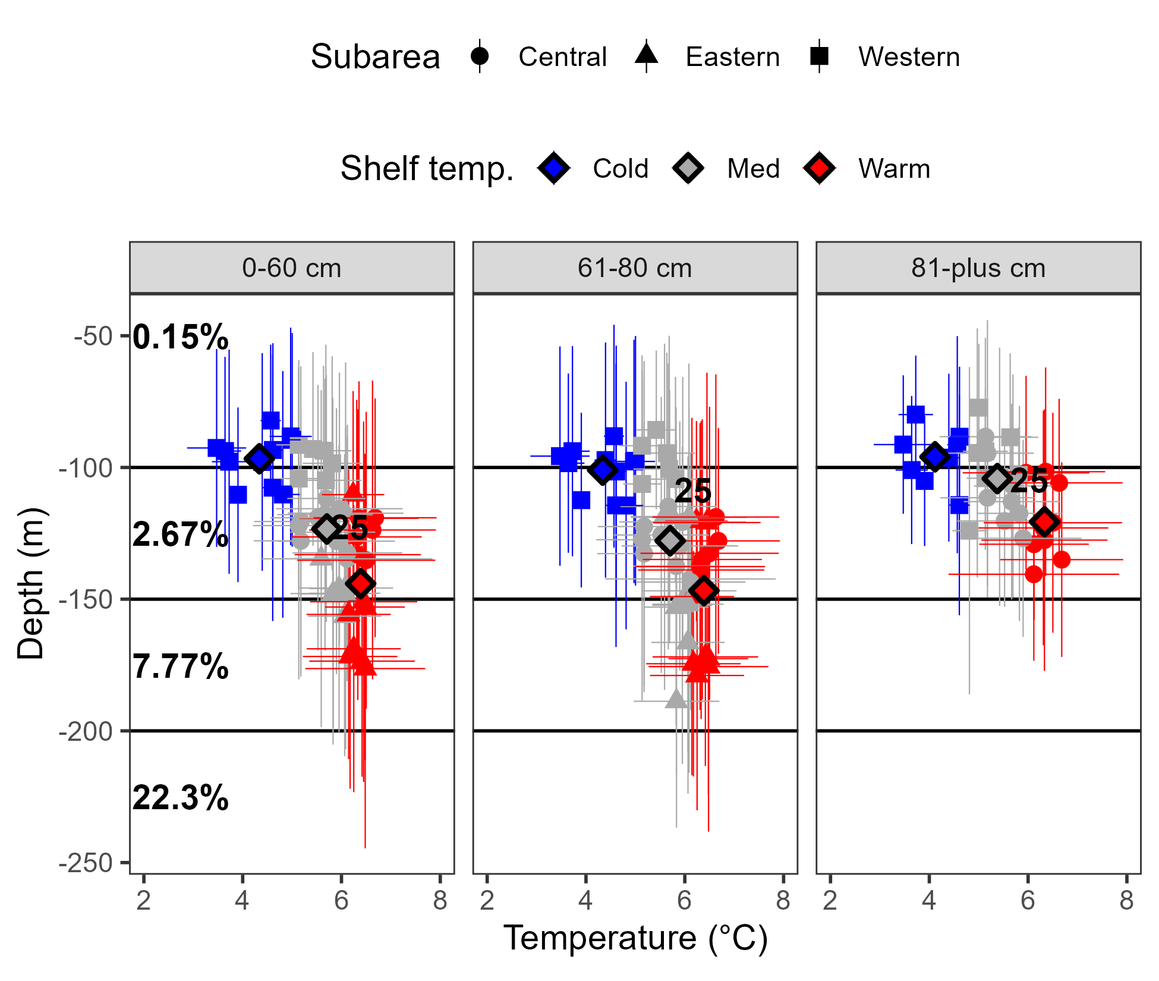
Surveys – Env data
Cod depth distribution related to temperature, variable overlap with AFSC longline survey distribution

Slide 19
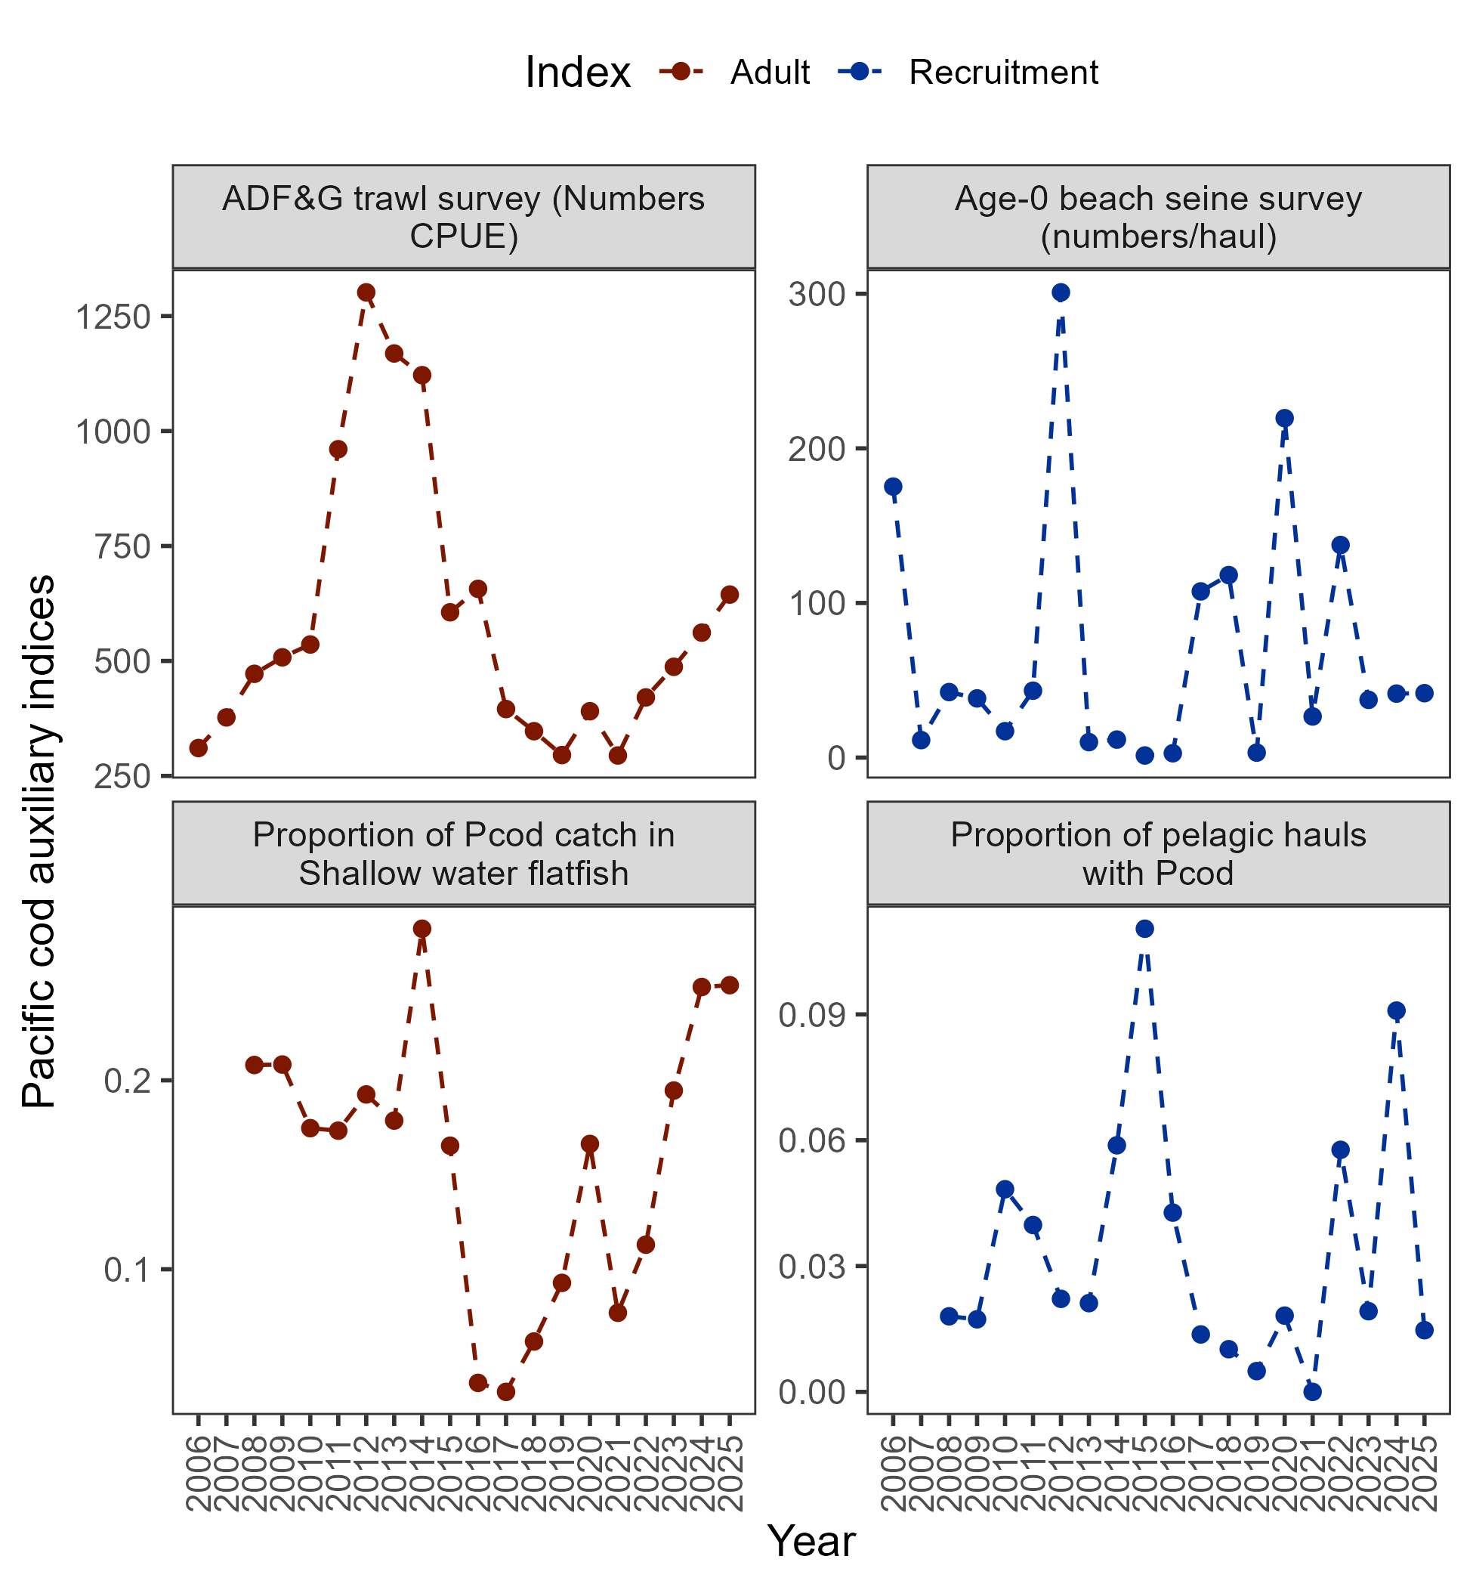
Data – auxiliary information
Adult indices:
Raw ADF&G Numbers CPUE increased (weight CPUE increased by 7.2%)
Proportion of cod in SWF catch stayed at >0.2
Recruitment indices:
Beach seine 2023-2025 were below average
Below avg in pelagic hauls with cod
+14.7%
+0.4%

Slide 20
Data – auxiliary information
Adult indices:
Raw ADF&G Numbers CPUE increased (weight CPUE increased by 7.2%)
Proportion of cod in SWF catch stayed at >0.2
Recruitment indices:
Beach seine 2023-2025 were below average
Below avg in pelagic hauls with cod
+14.7%
+0.4%

Slide 21

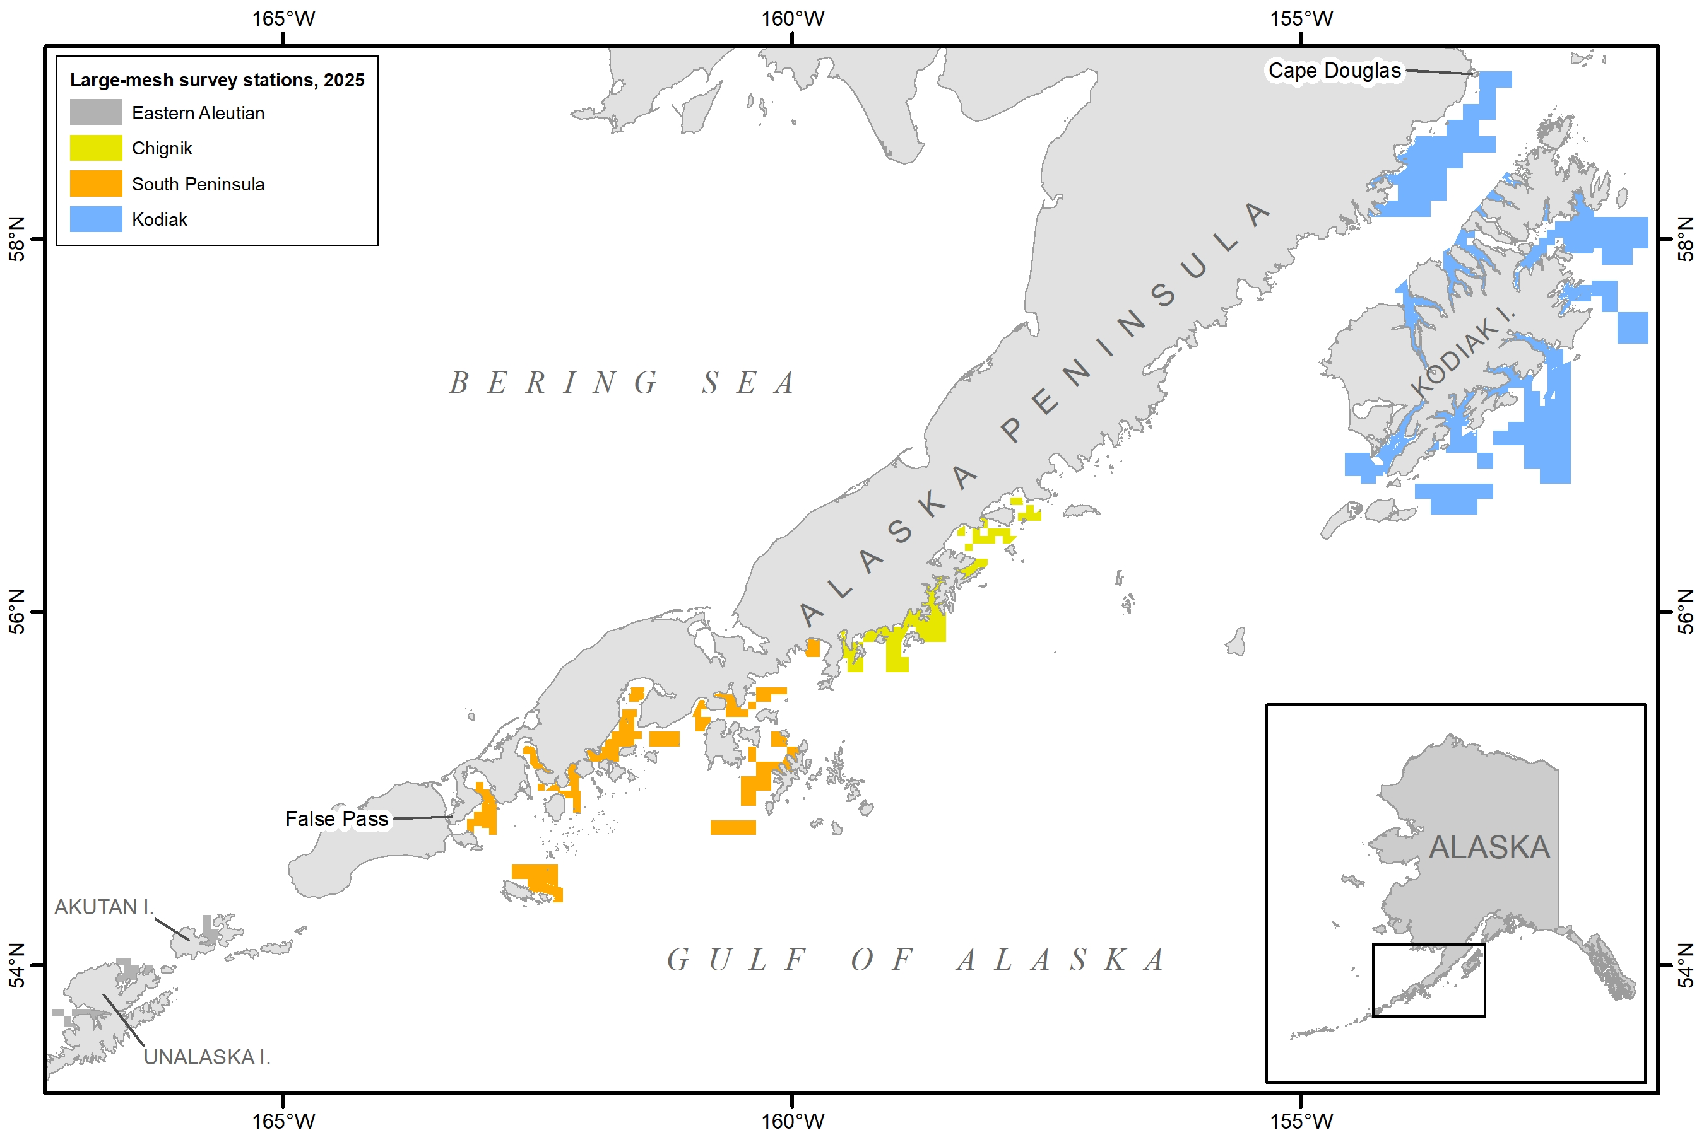
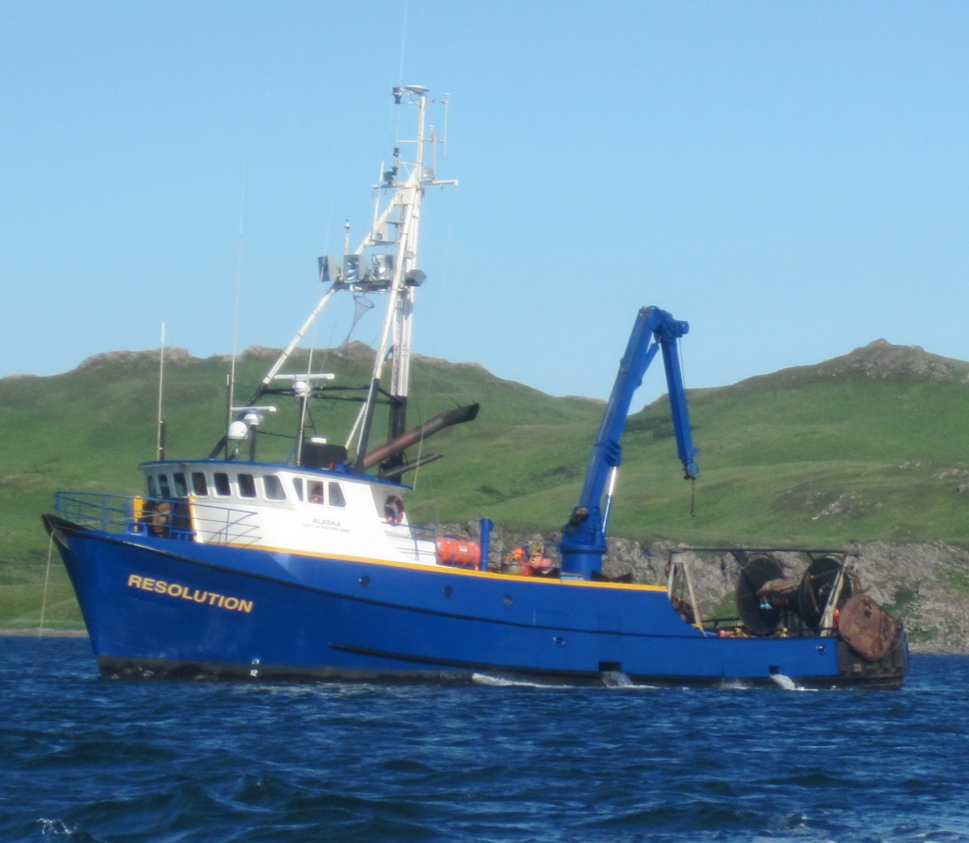
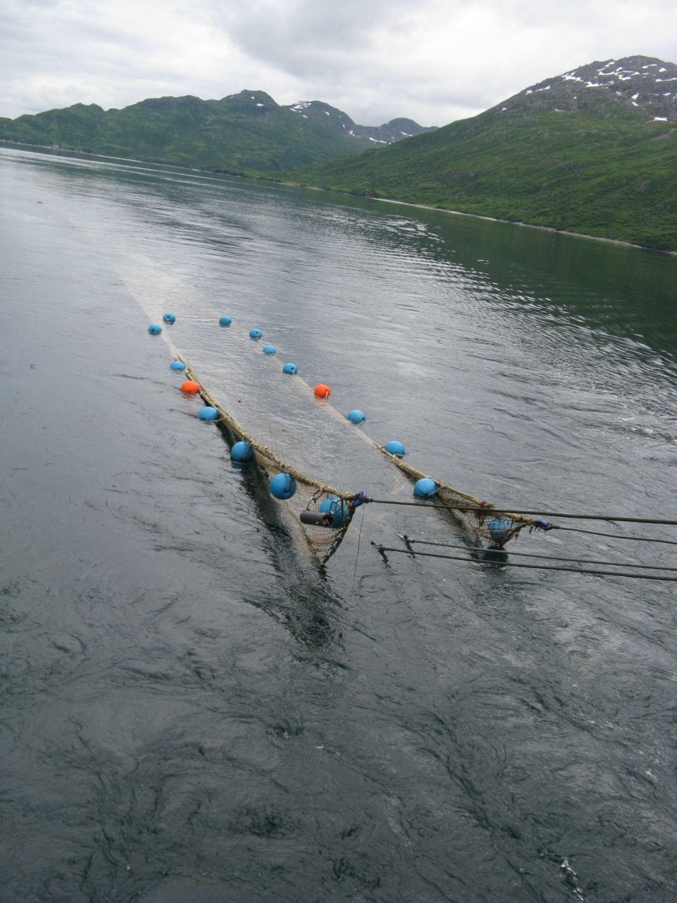
Data – auxiliary information
ADF&G Large-Mesh Trawl Survey
2025: 366 stations from Cape Douglas to Unalaska Island
R/V Resolution, 95 feet
400-Eastern otter trawl is towed for 1.0 nmi
A subsample is taken to determine species composition
Commercially-important species are measured
Notes:
This survey uses the 92 foot ADF&G research vessel Resolution. At each station a 400-mesh eastern otter trawl is towed for 1.0 nautical mile. After the catch is brought on board a subsample is taken and sorted by species to determine species composition and commercially-important species are measured. Specific methods used are comparable to other trawl surveys in Alaska.

Slide 22
ADF&G Large-Mesh Trawl Survey
2025 P. cod CPUE and abundance has increased to the highest level since 2014.
Eastern Aleutian, Chignik, and South Peninsula had increasing abundance, while Kodiak declined.
South Peninsula and Kodiak had more small fish.

Slide 23
Data – summary
Length comp trends:
No red flags, recent lengths consistent
Index trends:
Environmental trends:
2025 warmer than average, cod deeper
General trend is an increase in adult population

Slide 24
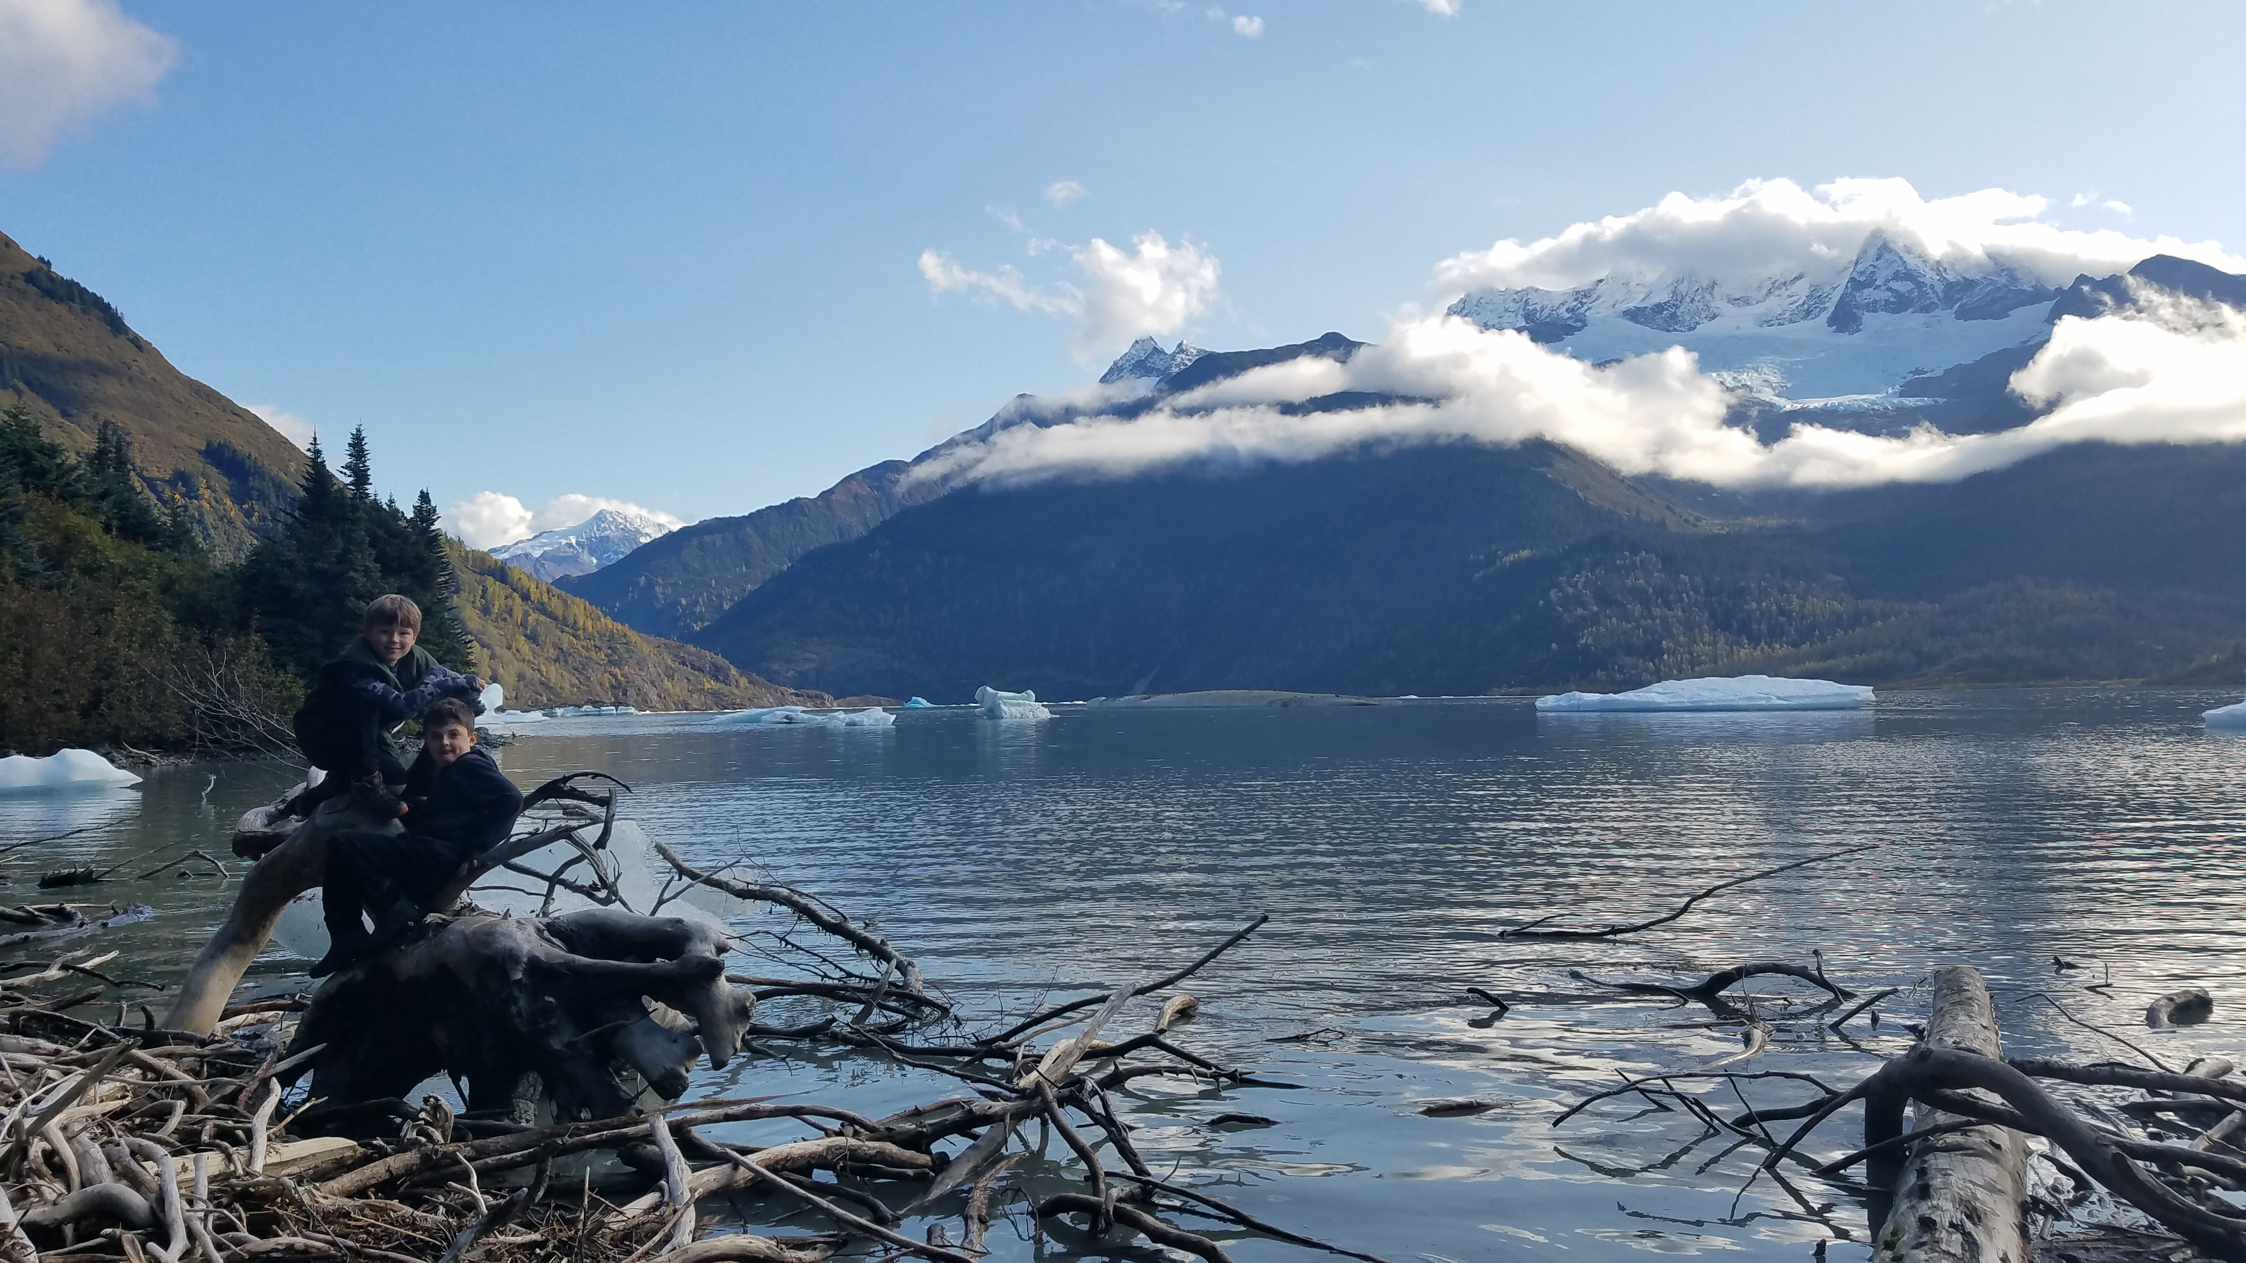
results
Data fits
Model 24.0 results
Model diagnostics
Recommendations

Slide 25
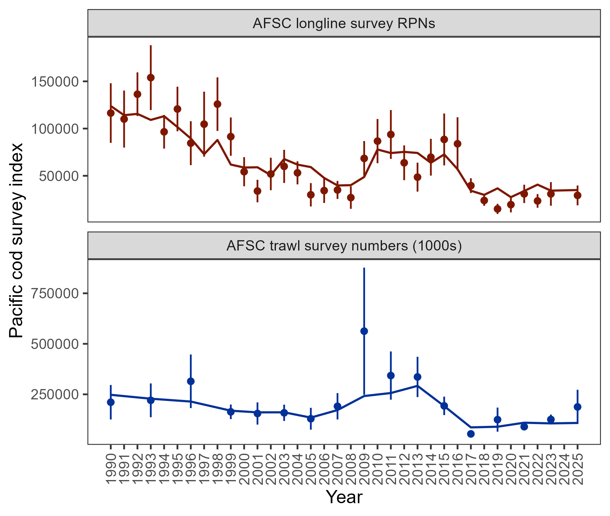
Results: data fits
Pattern of expecting larger RPN from longline survey than observed continues
Model does not fit increase in 2025 trawl survey increase
Model estimates represent balance between fitted indices
Consistent with 2024 assessment

Slide 26
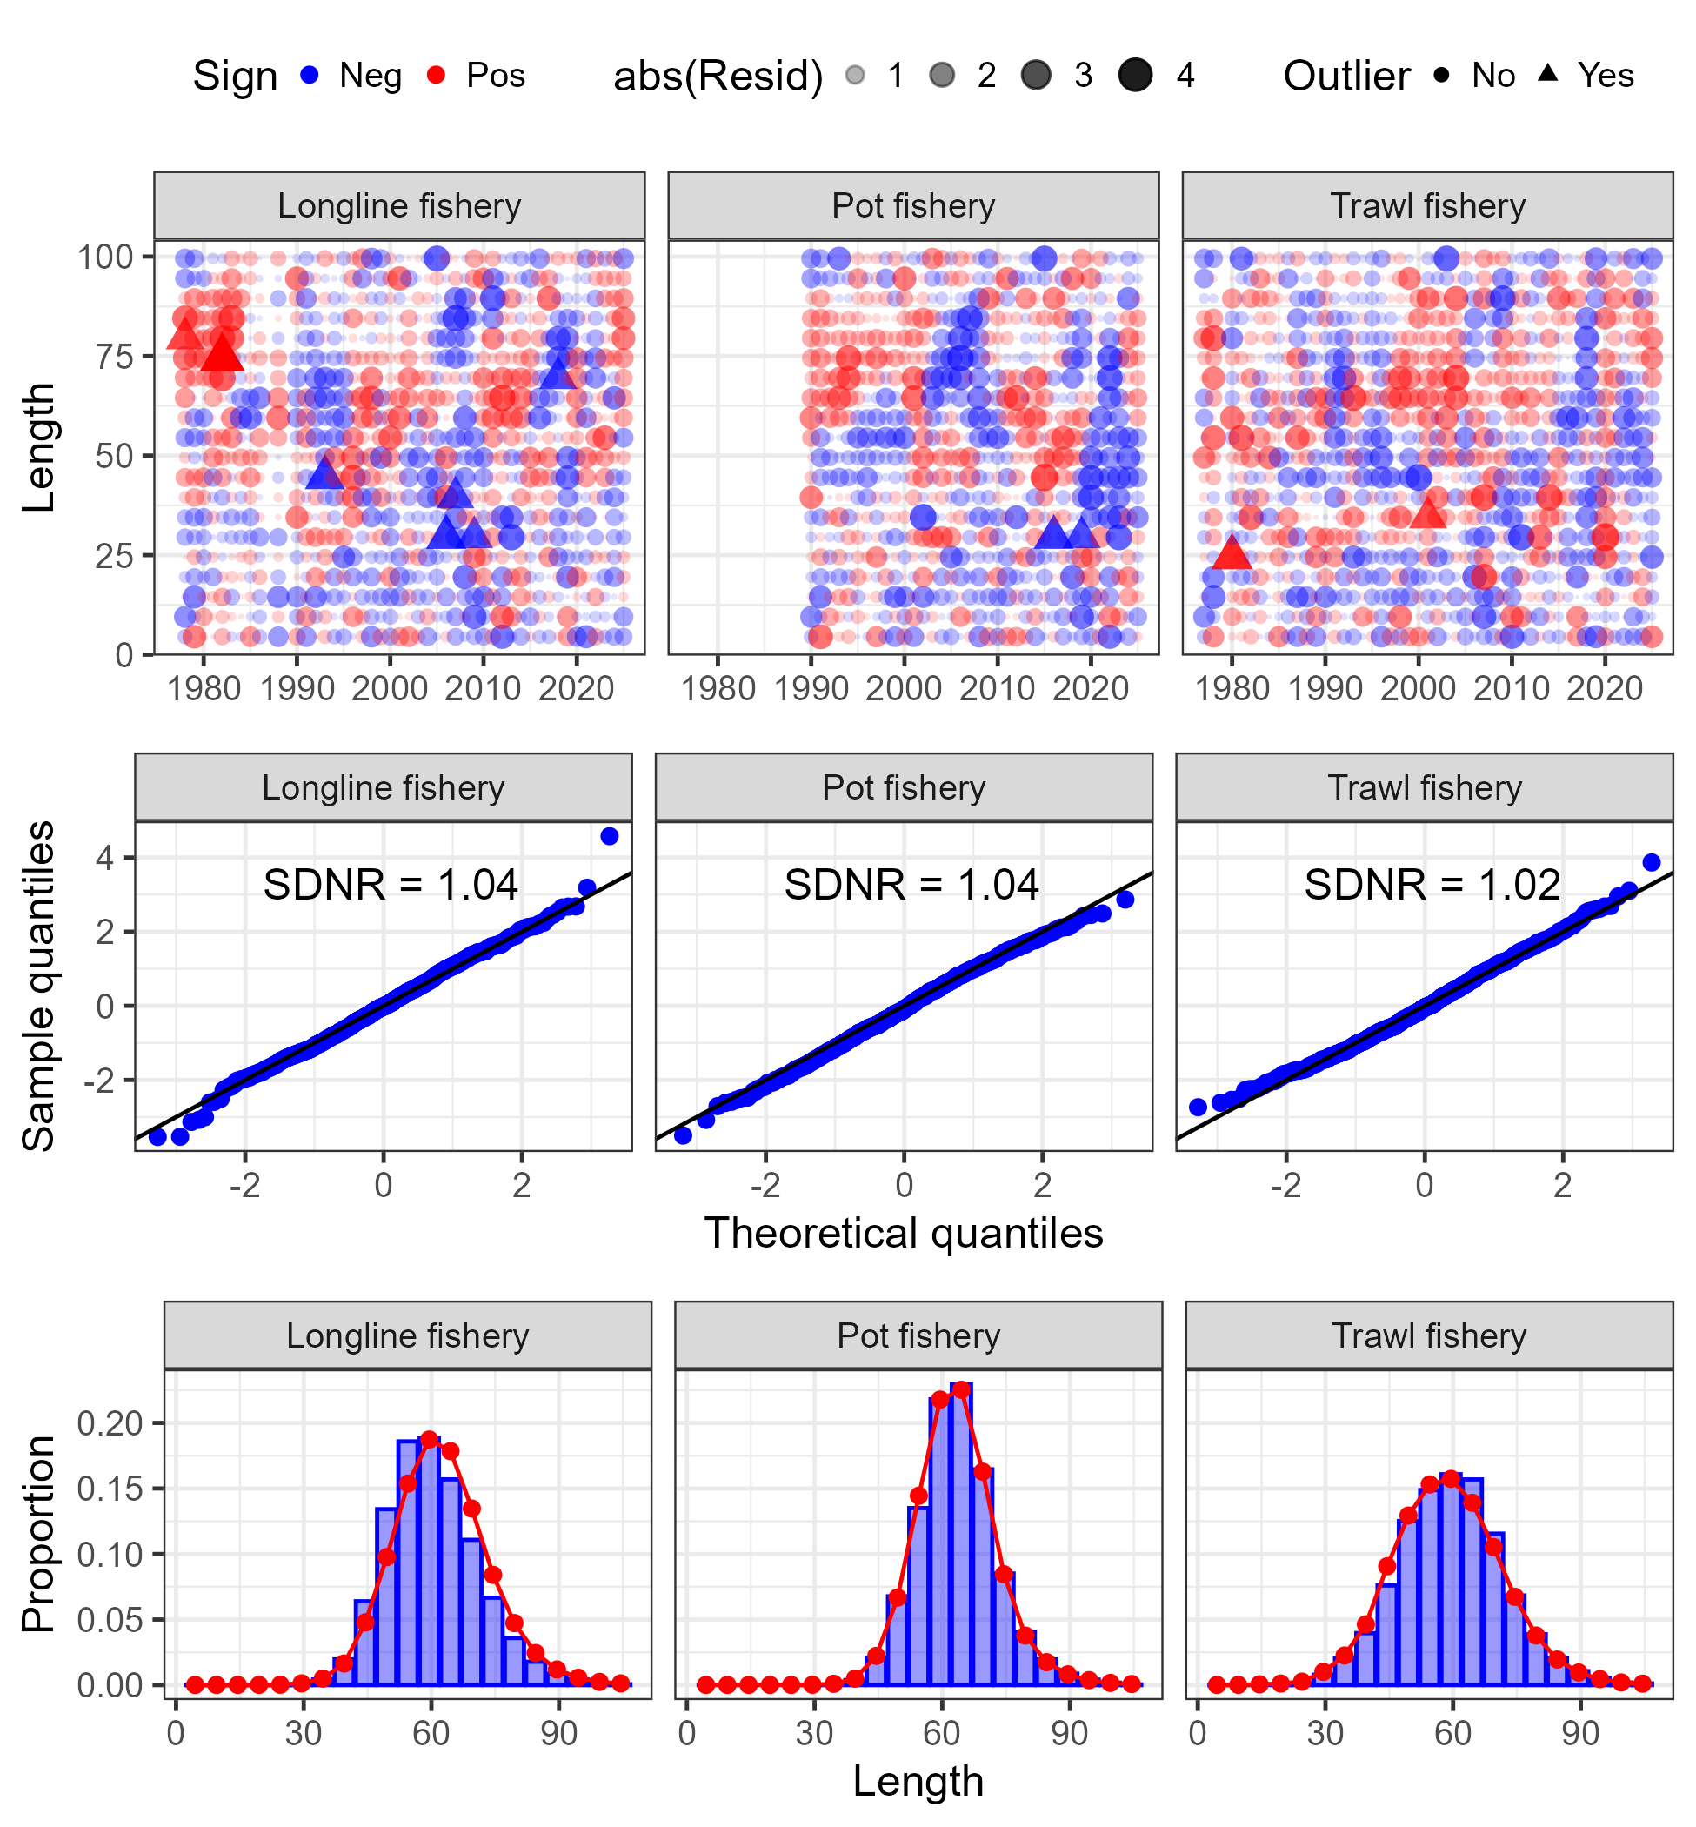
Results: data fits
No glaring sign of model misspecification in fit to fishery length composition

Slide 27
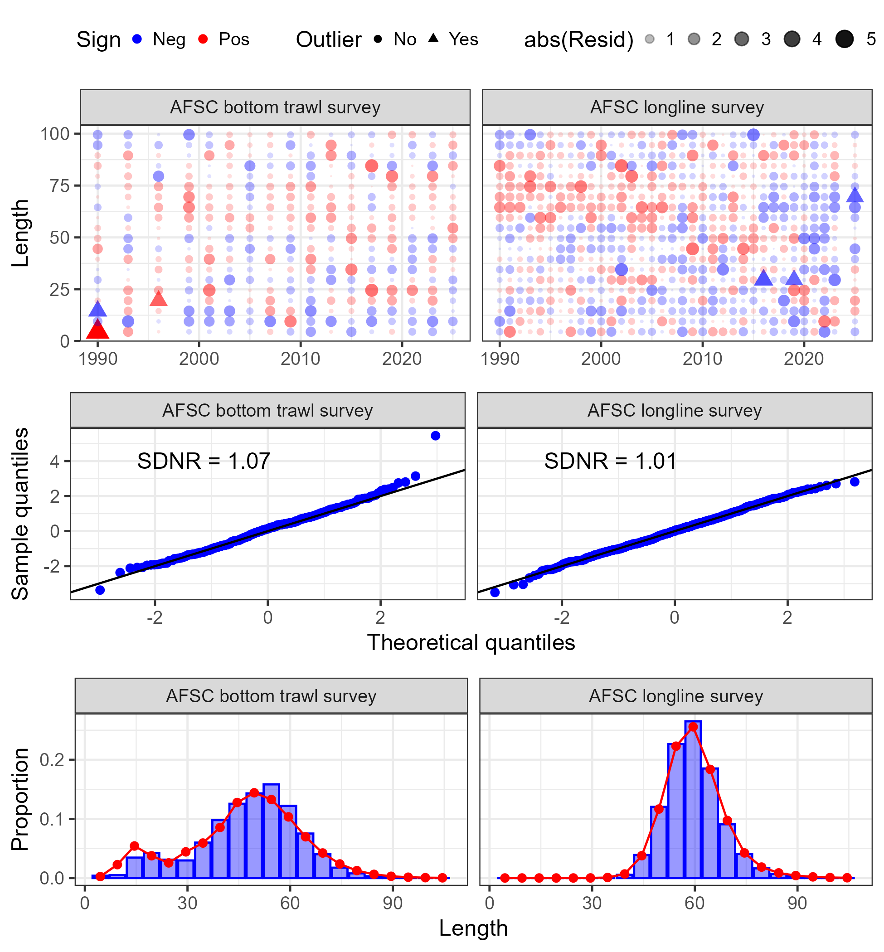
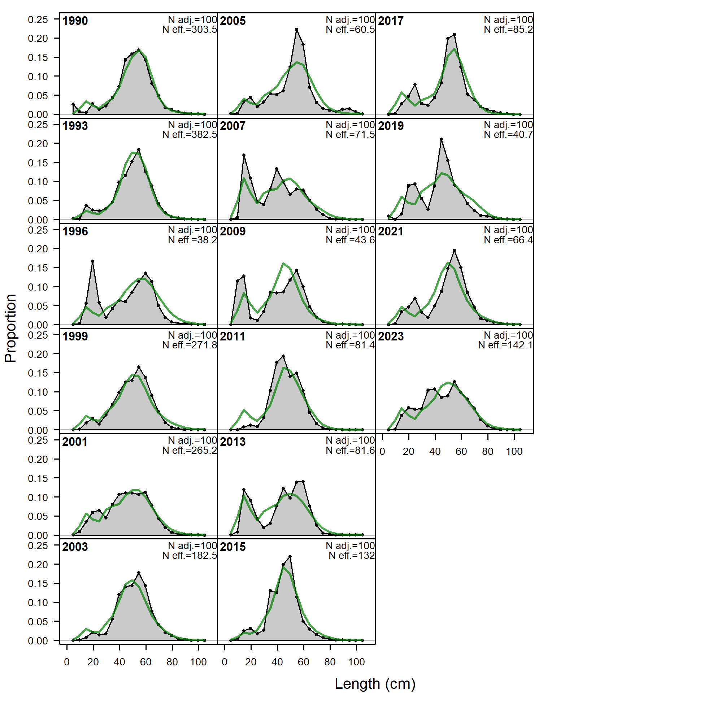
Results: data fits
No glaring sign of model misspecification in fit to survey length composition
But, some large residuals at smaller lengths in early trawl survey years and later longline survey years

Slide 28
Presented model diagnostics:
Retrospective: data and model
Other diagnostics:
Model convergence: final gradient was 6.45e⁻⁶
Jitter analysis: 50 at 5% CV, 46 converged, 74% to MLE
See in linked document:
Leave-one-out: leave a year of data out
Add-one-in: add one new source of data at a time
Profile for key parameters
MCMC: key parameter histograms, mixing, correlation
AFSC longline survey catchability sensitivity
Results: diagnostics

Slide 29
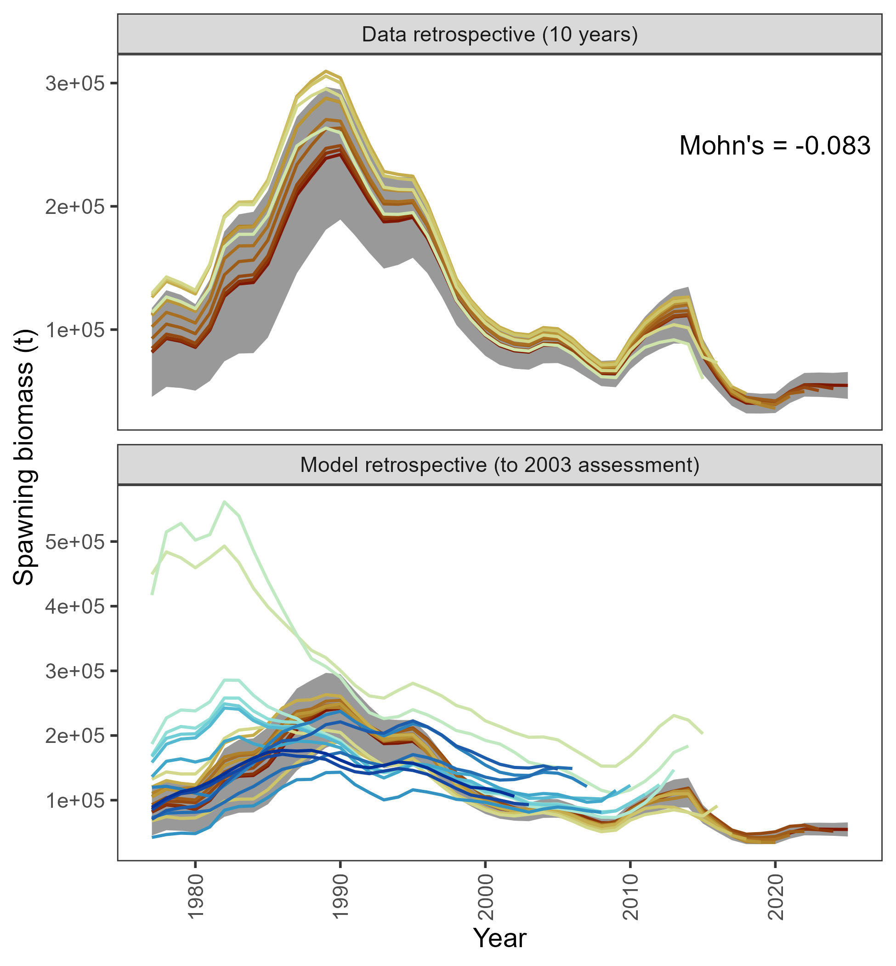
Data retrospective small & negative
Recent model retrospective consistent, but large retrospective pattern across models prior to 2015 assessment
Results: diagnostics

Slide 30
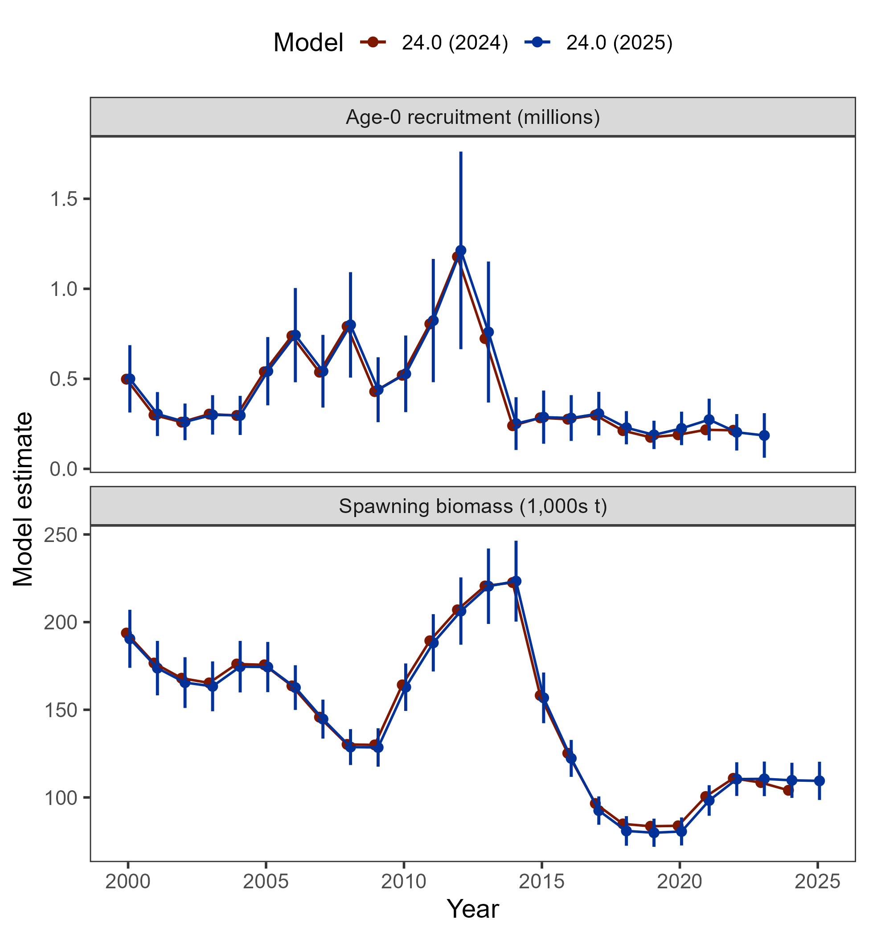
Overall, Model 24.0 in 2025 consistent with all results obtained in 2024
With new data:
Recruitment slightly increases for 2020 and 2021 year classes
Spawning biomass slightly decreases from 2017-2021, then increases after 2022
Results: comparison with 2024

Slide 31
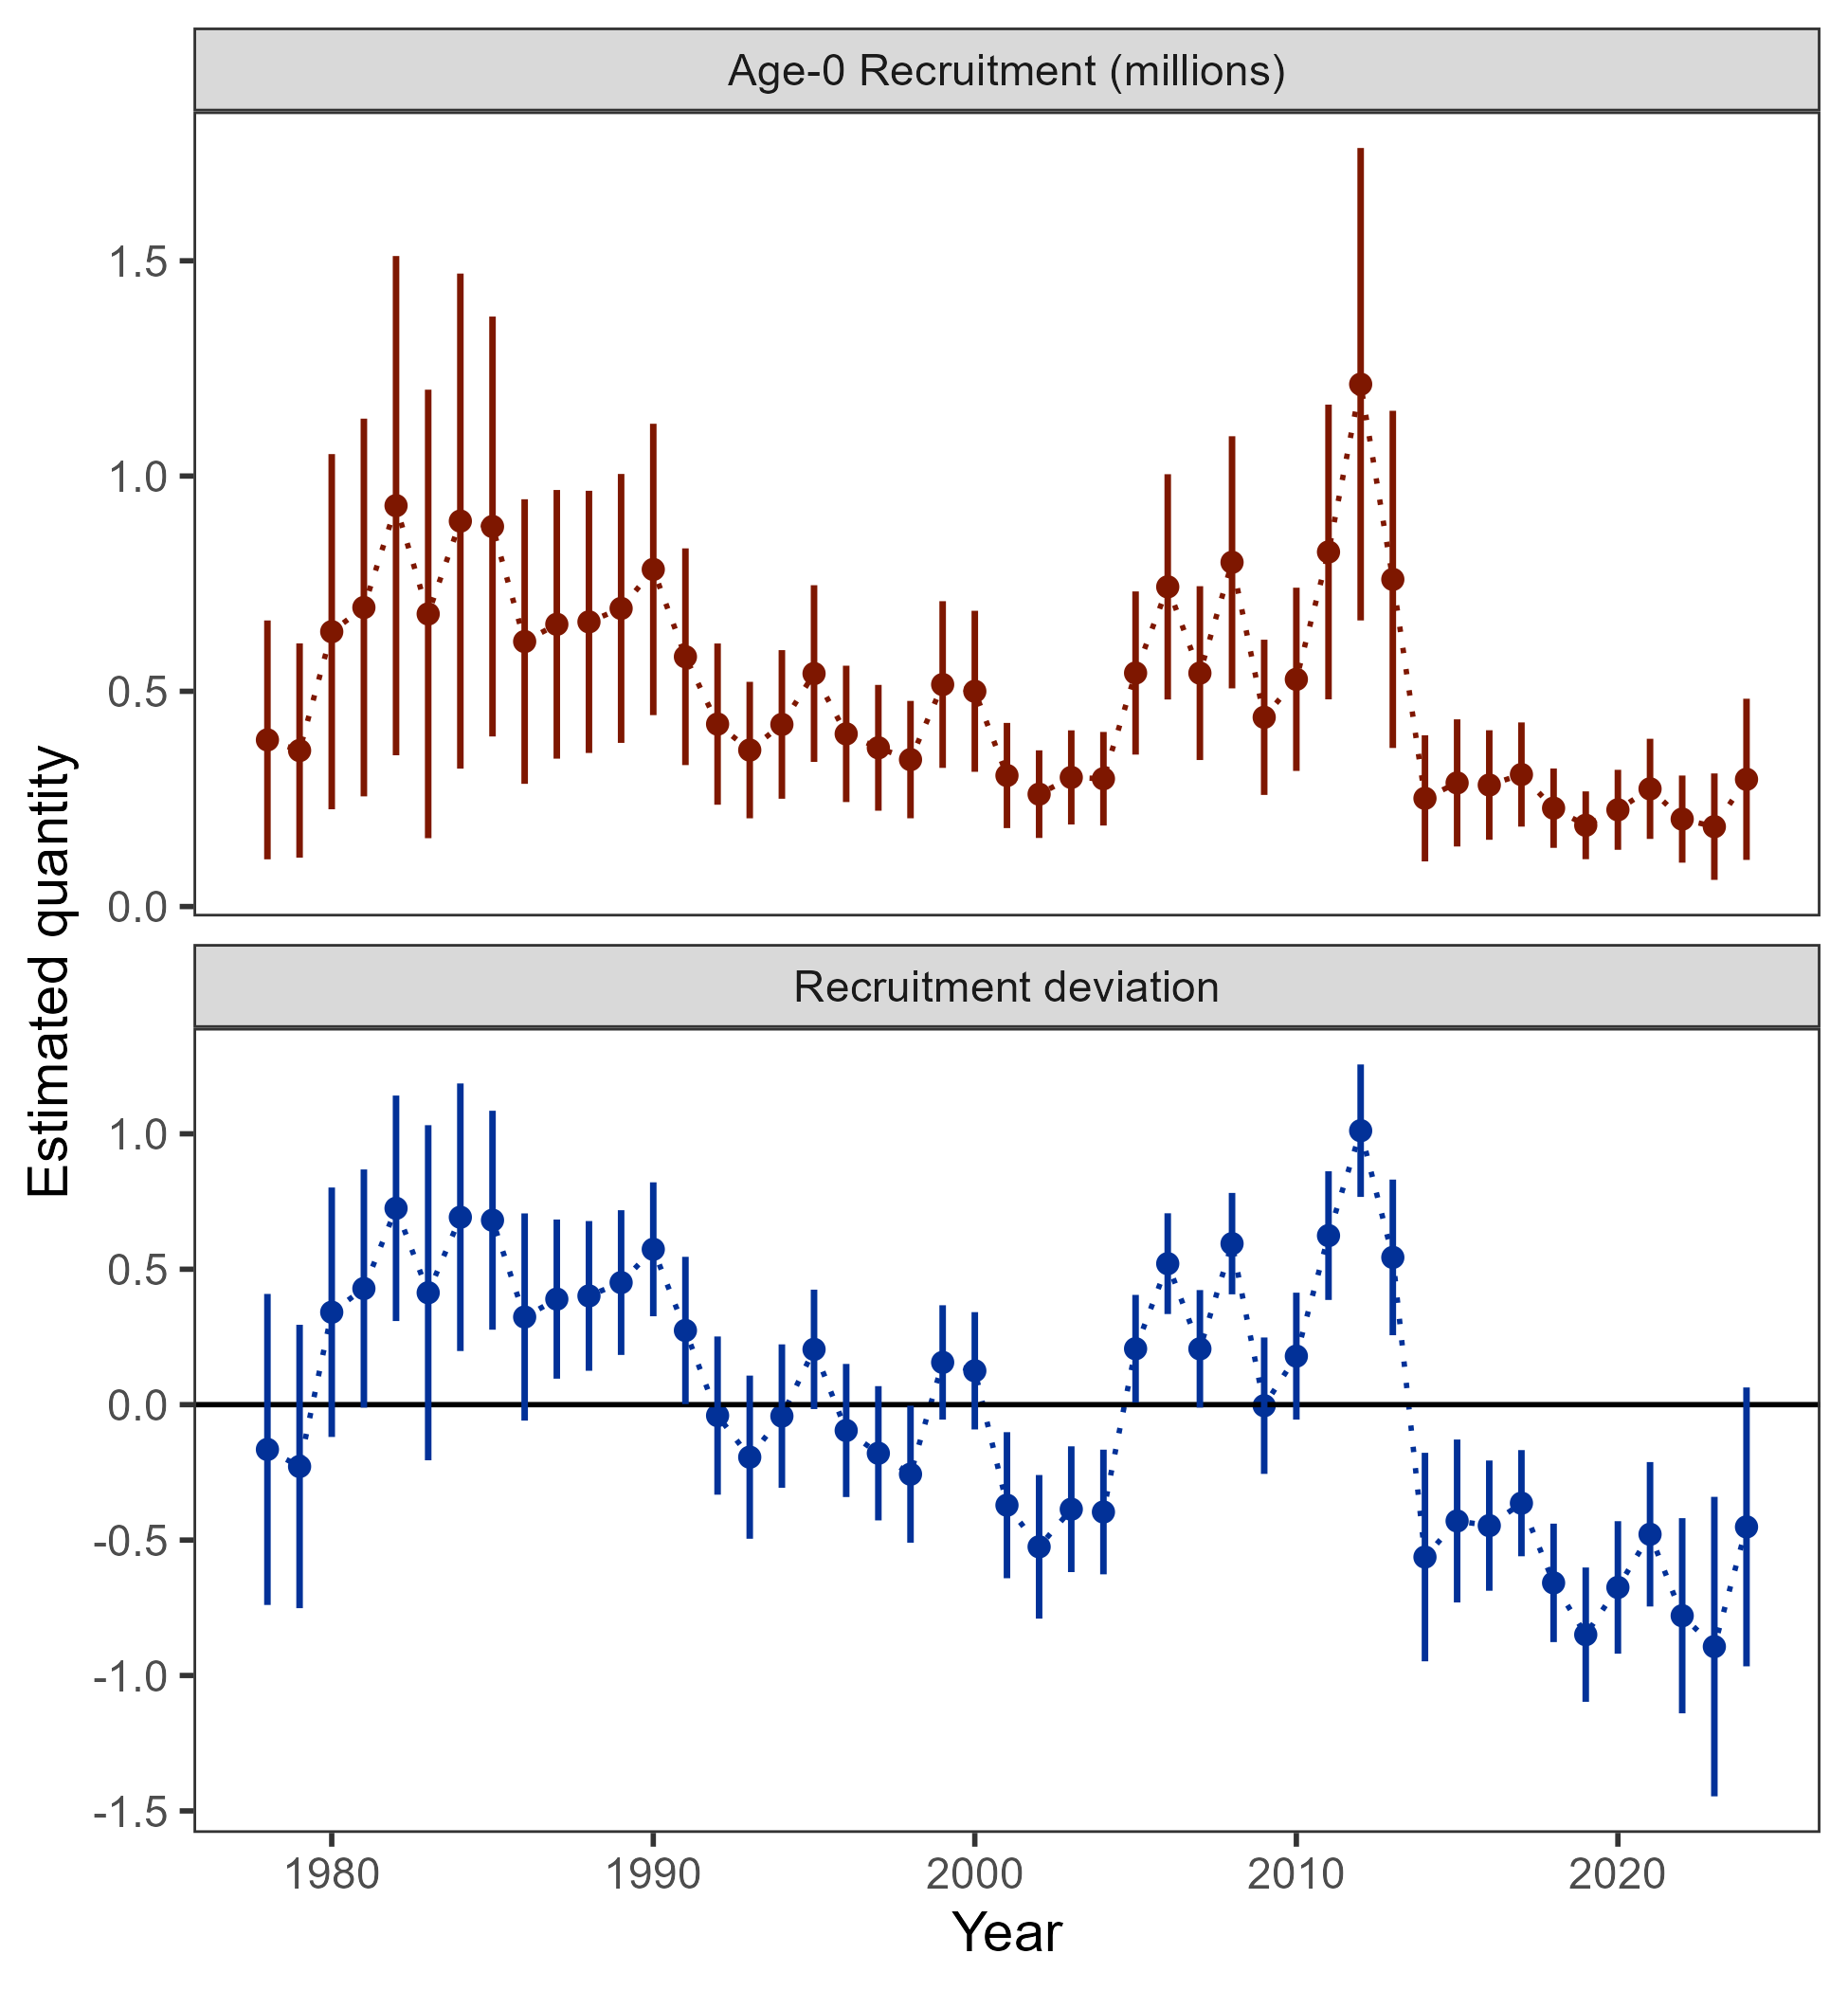
Results: recruitment estimates
Below average recruitment since 2014 (following a stanza of above avg recruitment)

Slide 32
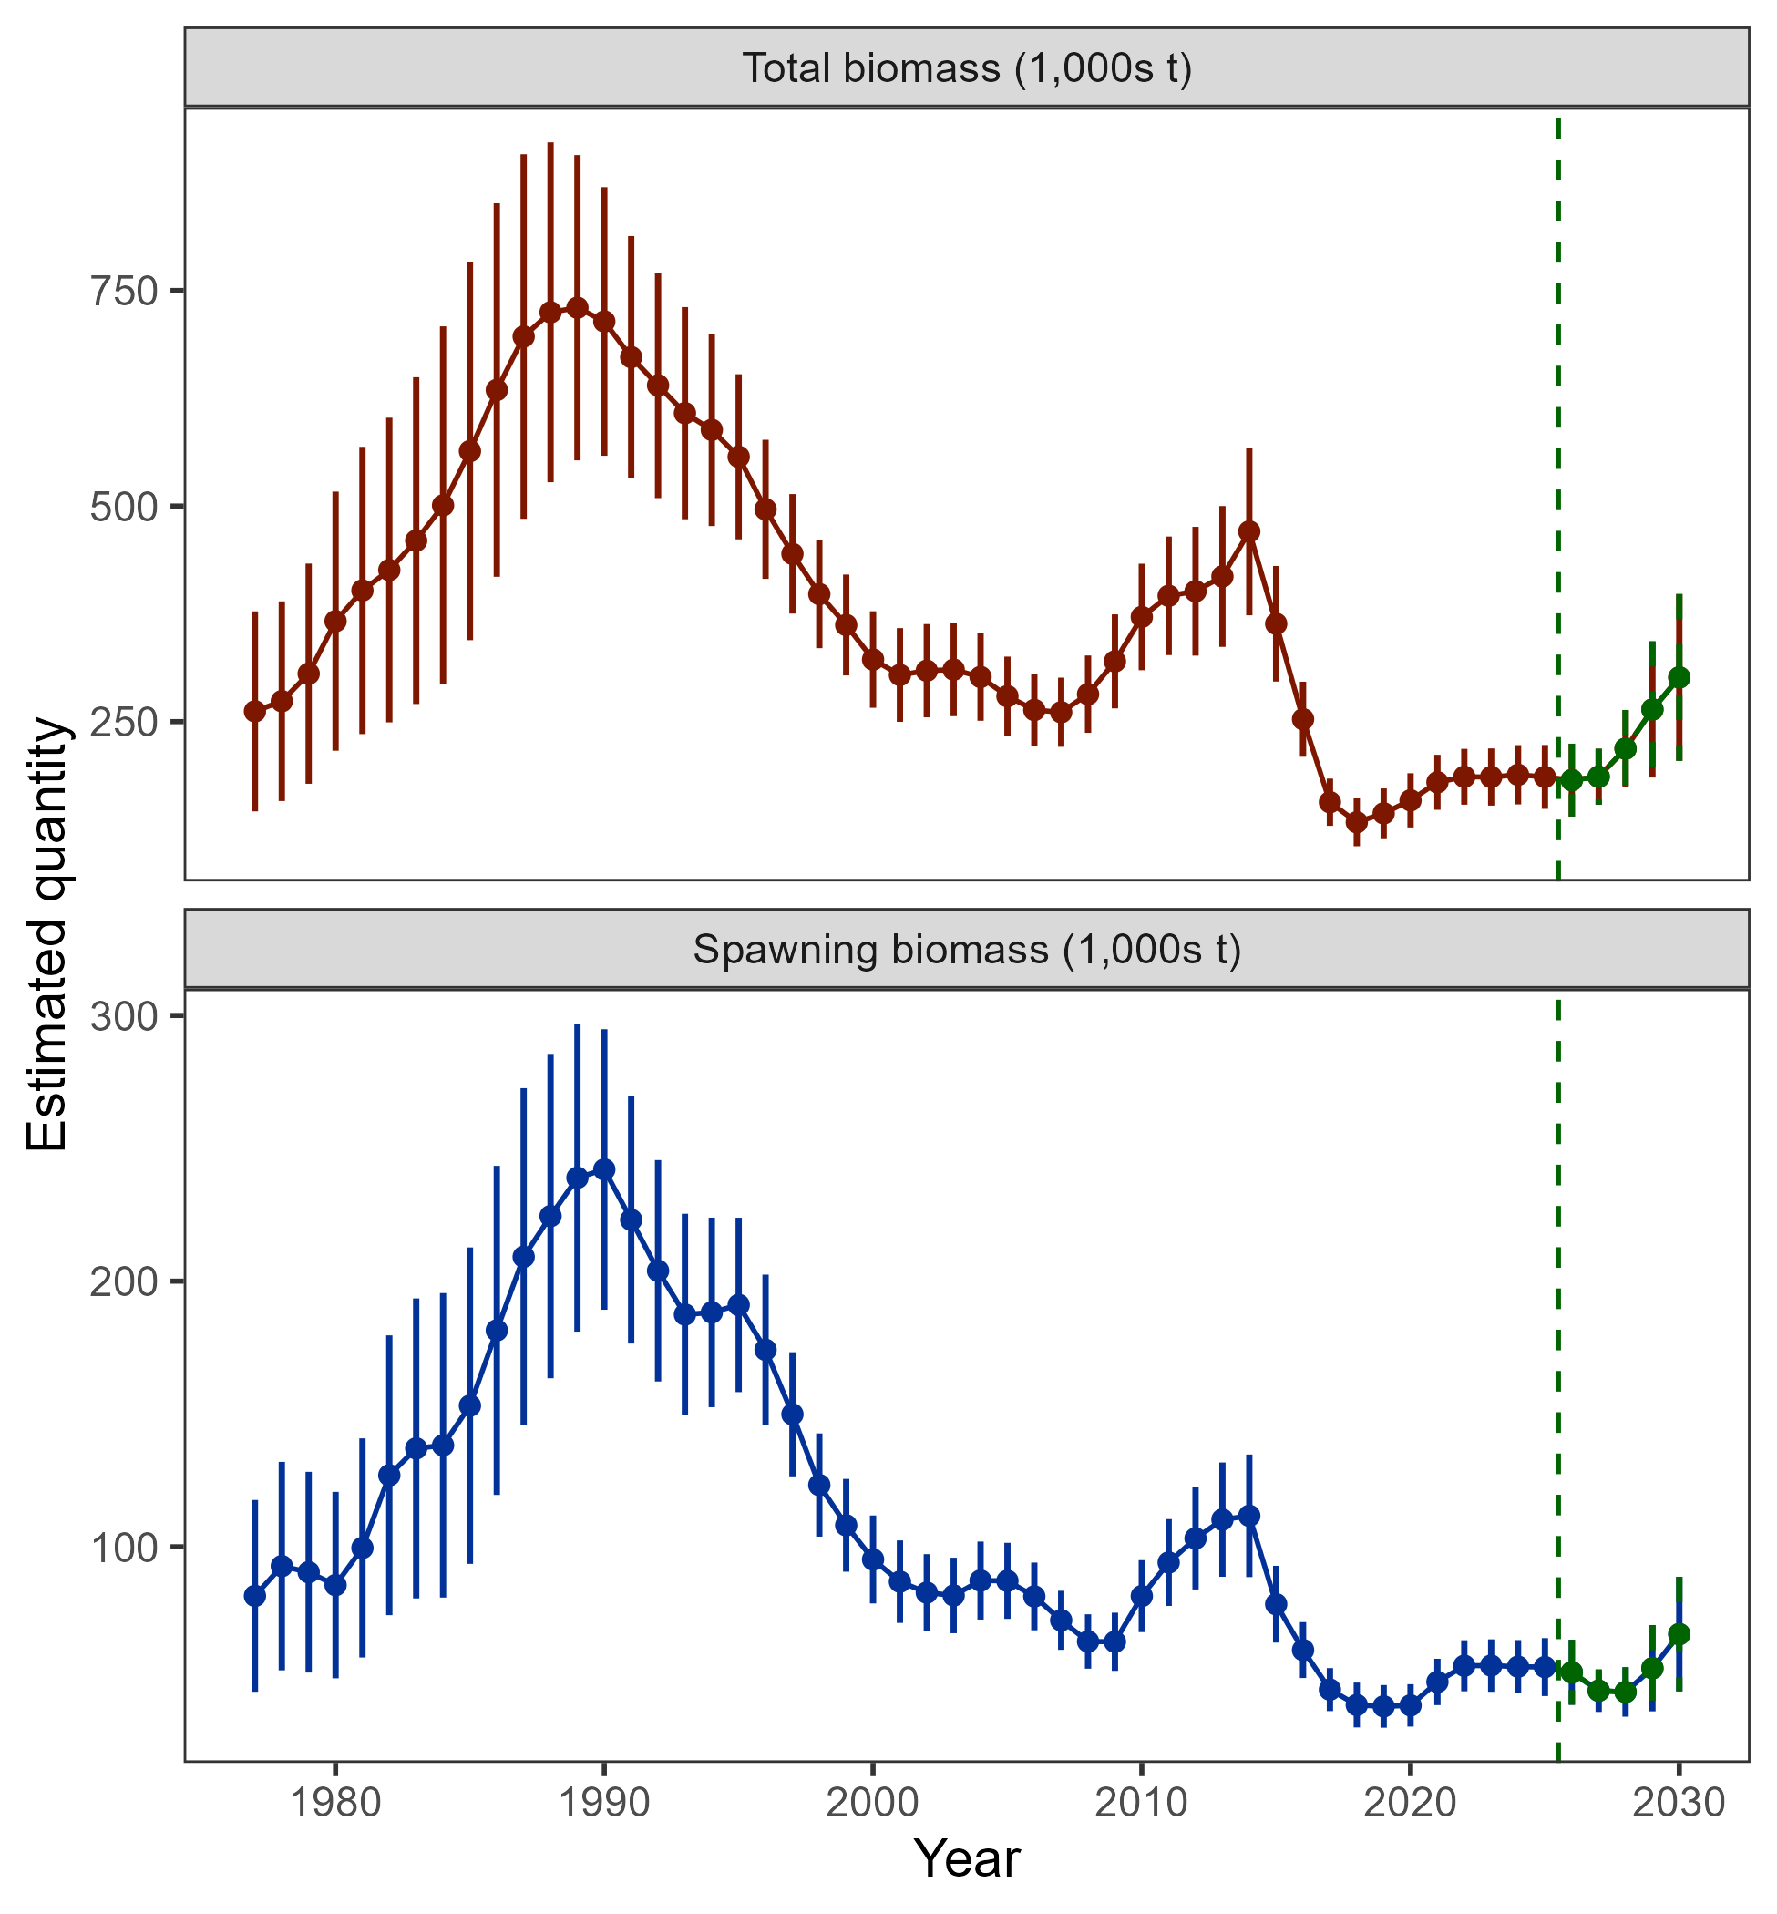
Results: biomass
Biomass projected to increase by 2030, but, based on realization of average recruitment

Slide 33
Stock status
Risk table
ABC/OFL recommendations
Apportionment
Results: recommendations

Slide 34

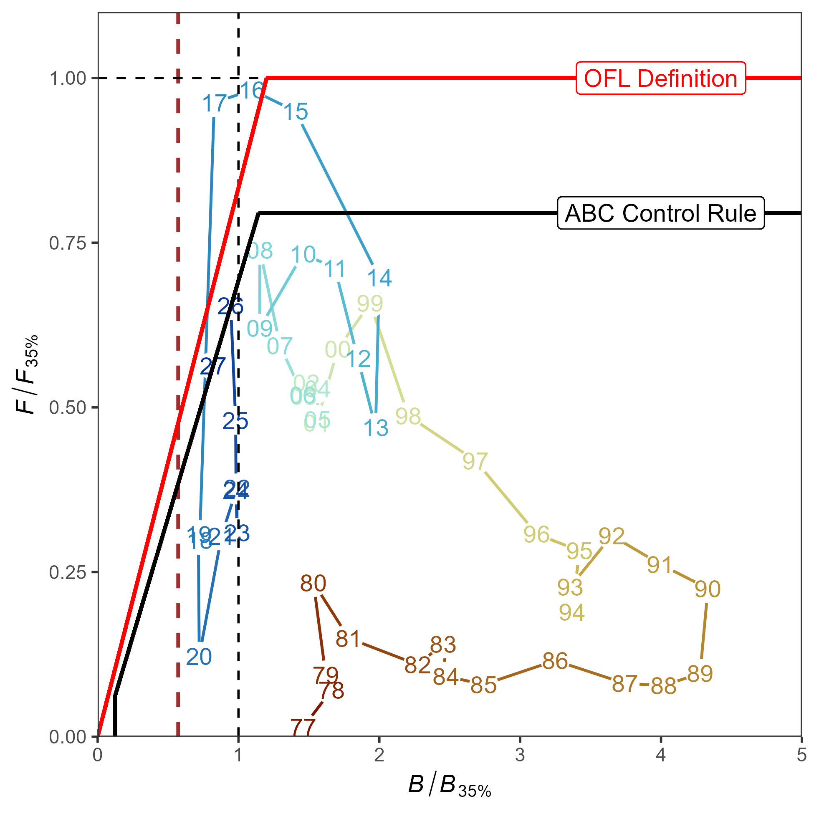
Stock status
Tier 3b: on the ramp
Estimated to be above B_{20%} (dashed red line), 2026 = B_{33.1%}
Projected to move down the ramp in 2027

Slide 35
Risk table

Slide 36
Risk table
Given historically low biomass and below avg recruitment (PopDy = 2) coupled with warmer than average ocean conditions (Eco = 2), there is increased risk to the GOA cod population this year
Should the 2026 ABC be reduced from maximum to mitigate this risk?

Slide 37
Risk table
Should the 2026 ABC be reduced from maximum to mitigate this risk?
Thinking through this question:
Data synthesis
Model evaluation
Projection considerations
Stock status and HCR
Have we been here before, and, what happened?

Slide 38
Risk table
Should the 2026 ABC be reduced from maximum to mitigate this risk?
Data synthesis:
Available population index data indicates an increase in the population since 2023/2024
AFSC longline survey exception, but, we’ve discussed why this result occurred, raw catch rates indicates increase
Available AFSC bottom trawl survey age and length composition consistently indicates age-1 – age-3 fish in population

Slide 39
Risk table
Should the 2026 ABC be reduced from maximum to mitigate this risk?
Model evaluation:
Model continues to estimate below average recruitment, but, these estimates do not fit the observed data well, particularly for smaller/younger fish
There is a possibility that the model is misrepresenting the estimated recruitment due to use of length composition rather than age composition to inform recruitment
Model does not reflect increase in AFSC bottom trawl survey

Slide 40
Risk table
Should the 2026 ABC be reduced from maximum to mitigate this risk?
Projection considerations:
Continue to note the average recruitment concern in projected biomass, when recent recruitment estimated to be below average since 2014
This potentially results in overly-optimistic long-term projections, but does not have large effect on 2026 ABC
Noted sharp decline in 2027 ABC due to projected decline in spawning biomass coupled with moving down ramp of HCR
Assumption of utilizing full ABC in terminal year of model for projections reduces 2026 recommended ABC by 5% as compared to using observed catch proportions since fishery closure in 2020

Slide 41
Risk table
Should the 2026 ABC be reduced from maximum to mitigate this risk?
Stock status and HCR:
Stock is currently in Tier 3b, on the ramp of the HCR
Based on the HCR and projected stock status, F_{40%} reduced by 18% to obtain 2026 F_{ABC}

Slide 42
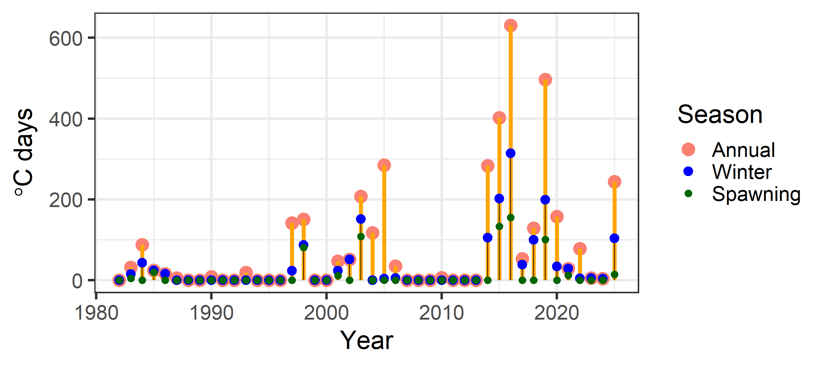
Risk table
Should the 2026 ABC be reduced from maximum to mitigate this risk?
Have we been here before, and, what happened?
Recognizing that no two years are exactly the same, highlight two recent years in which number of heatwave days similar to 2025: 2014 and 2019

Slide 43
Risk table
Should the 2026 ABC be reduced from maximum to mitigate this risk?
Have we been here before, and, what happened?
2014: precipitated severe heatwave in 2015 and 2016, following which population collapses
Model estimates from 2014/2015 much different than current model
Spawning biomass in 2014 250% larger than Model 24.0 2014 estimate
Adopted 2015 ABC 150% larger than recommended 2026 ABC
Standardizing ABC as a proportion of total biomass and comparing between 2015 and 2026, 2026 ABC 24% smaller than what was adopted in 2015

Slide 44
Risk table
Should the 2026 ABC be reduced from maximum to mitigate this risk?
Have we been here before, and, what happened?
2019: Model recommendation in 2019 resulted in 2020 fishery closure
After 2019, survey indices have increased, presumably reflecting advantageous conditions for cod population due to improvement in ecosystem conditions after 2019
2019 year-class estimated to be smallest in time-series, suspect that 2025 year-class could be of similar magnitude
While a number of improvements to the model and data have been implemented since 2019, Model 24.0 is fundamentally the same model as used in 2019 to recommend the fishery closure
In spite of historically low levels of biomass, the population has continued to increase since 2019 without additional buffers applied to recommended ABCs

Slide 45
Risk table
Should the 2026 ABC be reduced from maximum to mitigate this risk?
Summary: A number of buffers are ‘baked-in’ to this assessment, including catch assumptions in projections, stock status and the HCR, and model development over time
But, do these serve to mitigate the risk identified?
It is not clear to what extent these buffers serve to mitigate the increase risk highlighted in 2025 that could effect the population in 2026
It remains unknown if conditions in 2025 will persist into 2026
An additional buffer to the 2026 ABC could be considered, however,
There is no quantitative method available with clear objectives from which to derive the additional buffer, it remains a subjective decision
There is no understanding of any measurable risk reductions that have occurred due to buffers that have been implemented across stocks to inform the magnitude of buffers

Slide 46
Risk table
Should the 2026 ABC be reduced from maximum to mitigate this risk?
Taken together, a reduction from maximum ABC in 2026 is not recommended, while at the same time acknowledge the increased risk associated with this recommendation

Slide 47
ABC/OFL recommendations
Recommend Model 24.0: 29% increase in 2026 ABC compared to 2025
Quantity | As estimated or specified last year for: |  | As estimated or specified this year for:
 | 2025 | 2026 | 2026 | 2027
M (natural mortality rate) | 0.49* | 0.49* | 0.5* | 0.5*
Tier | 3b | 3b | 3b | 3b
Projected total (age 0+) biomass (t) | 177,497 | 200,521 | 182,156 | 186,118
Female spawning biomass (t)
Projected | 46,920 | 44,674 | 52,772 | 45,838
B_{100%} | 163,585 | 163,585 | 159,595 | 159,595
B_{40%} | 65,434 | 65,434 | 63,838 | 63,838
B_{35%} | 57,255 | 57,255 | 55,858 | 55,858
F_{OFL} | 0.57 | 0.51 | 0.68 | 0.54
maxF_{ABC} | 0.46 | 0.43 | 0.54 | 0.47
F_{ABC} | 0.46 | 0.43 | 0.54 | 0.47
OFL (t) | 38,688 | 33,099 | 49,782 | 38,812
maxABC (t) | 32,141 | 30,193 | 41,520 | 32,209
ABC (t) | 32,141 | 30,193 | 41,520 | 32,209
Status | As determined last year for: |  | As determined this year for:
 | 2023 | 2024 | 2024 | 2025
Overfishing | No | n/a | No | n/a
Overfished | n/a | No | n/a | No
Approaching overfished | n/a | No | n/a | No

Slide 48

apportionment
Two REMA model configuration changes recommended for GOA Biologically informed Recommended Distributions (BRD)
Estimate single process error parameter across GOA subregions
Estimate additional observation error parameter for GOA bottom trawl survey
These REMA model configurations previous adopted for GOA Thornyhead stock complex (Echave et al. 2022, Siwicke et al. 2024)

Slide 49
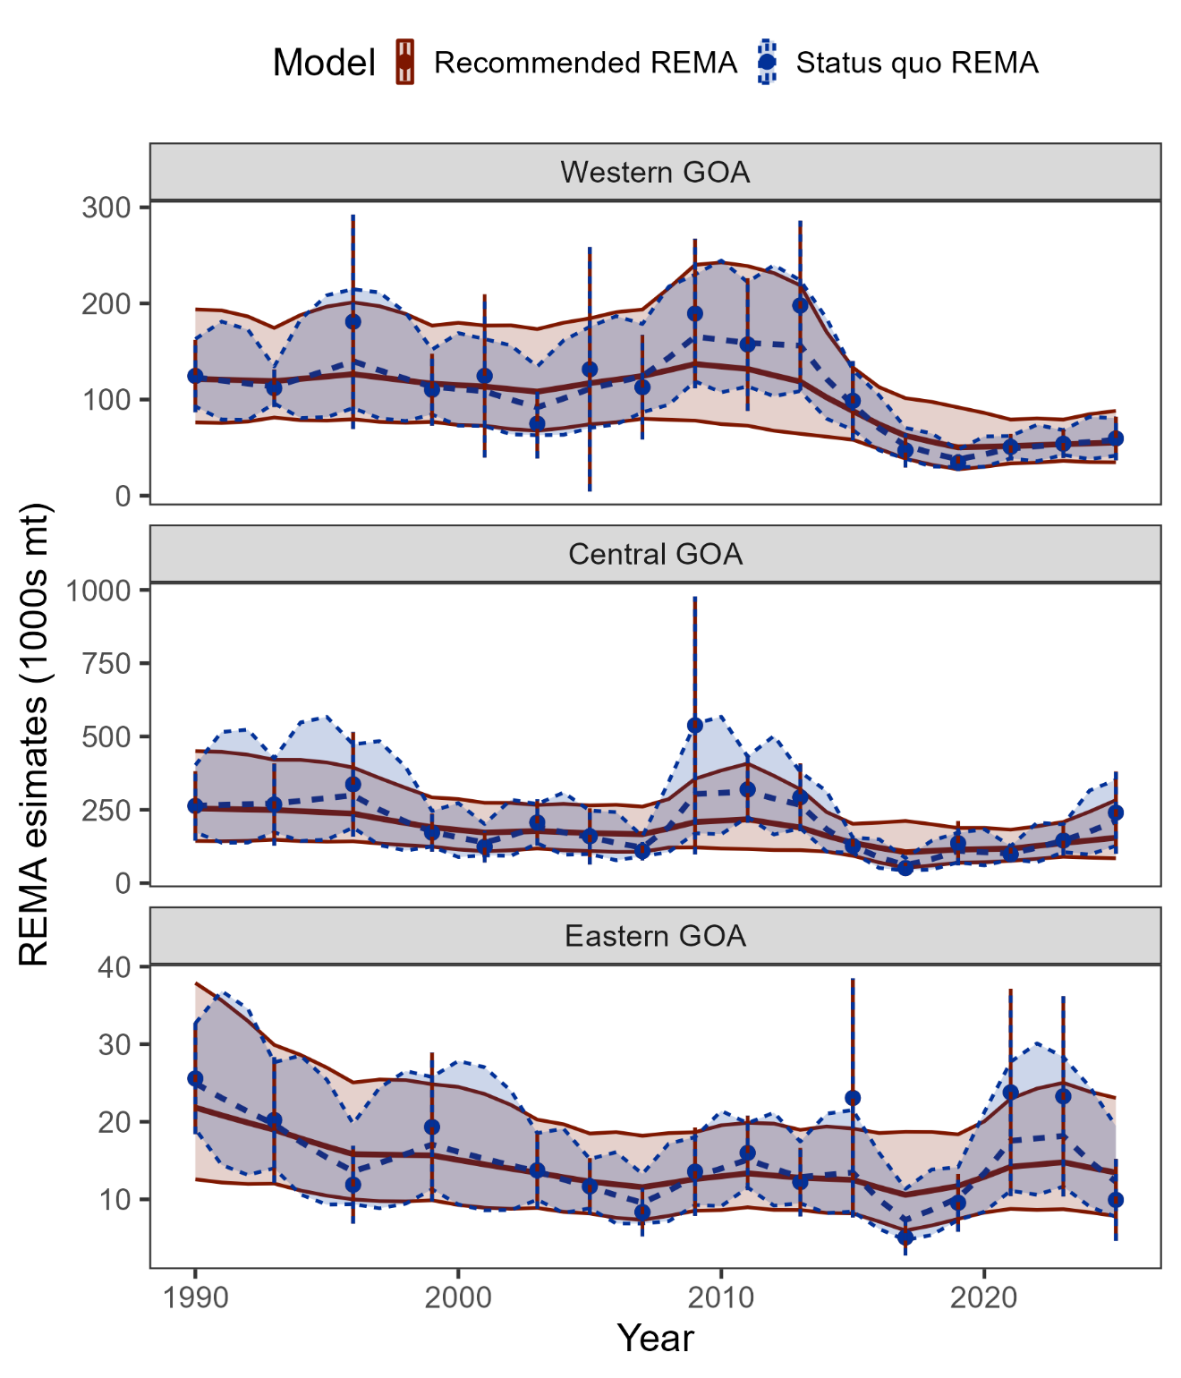
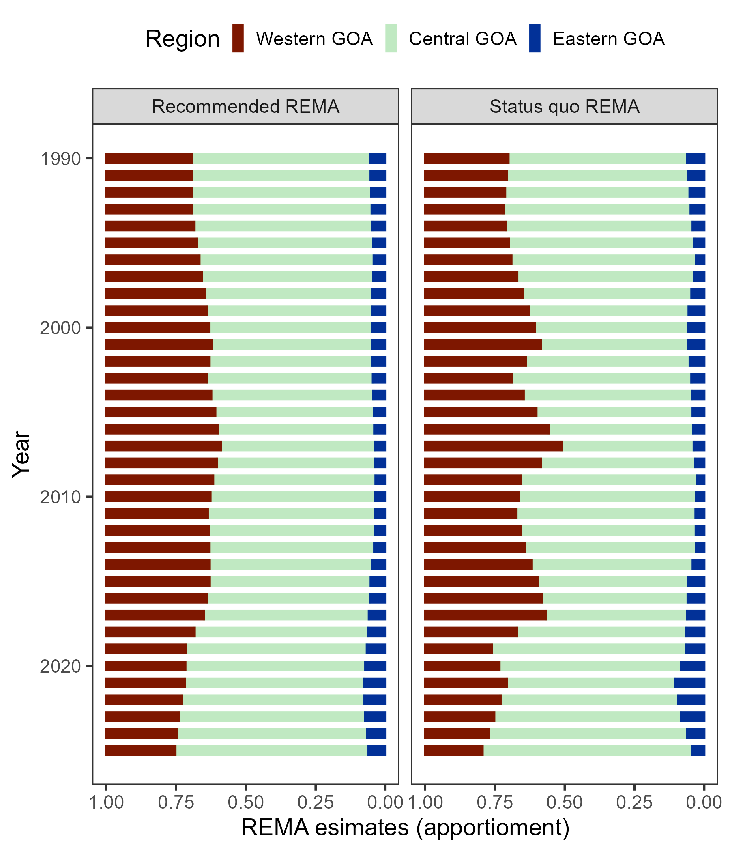
apportionment
Recommended REMA configuration changes serve to:
Smooth estimates of subregion biomass and uncertainty that is reflective of primary assessment model estimates of biomass,
Provide apportionment estimates that do not result in drastic and improbable shifts in distribution that are inconsistent with our understanding of cod life history and movement

Slide 50
apportionment
Comparison among adopted BRDs from 2025, BRDs from status quo REMA model, and BRDs from recommended REMA model:
2-year projected BRDs from recommended REMA model
 | Western | Central | Eastern | Total
Previous apportionment | 27.1% | 63.8% | 9.1% | 100%
2025 BRD | 8,710 | 20,506 | 2,925 | 32,141
Status quo apportionment | 20.6% | 75.1% | 4.3% | 100%
2026 BRD | 8,553 | 31,182 | 1,785 | 41,520
Recommended apportionment | 24.8% | 69.2% | 6% | 100%
2026 BRD | 10,297 | 28,732 | 2,491 | 41,520
 | Western | Central | Eastern | Total
Area apportionment | 24.8% | 69.2% | 6% | 100%
2026 BRD | 10,297 | 28,732 | 2,491 | 41,520
2027 BRD | 7,987 | 22,289 | 1,933 | 32,209

Slide 51
Questions?

